Slide 1

Evidence-Based Objective Assessment of Infant Hearing: Frequency-Specific ABR and More
James W. Hall III, PhD
Professor
Salus at Drexel University
University of Hawaii
jh4325@drexel.edu
Jayashree Seethapathy, PhD
Associate Professor and Head
Department of Audiology
Sri Ramachandra Faculty of Audiology and Speech Pathology

Slide 2
Evidence-Based Objective Assessment of Infant Hearing: Frequency-Specific ABR and More
Time-Ordered Agenda
9:00 am Introduction and learning objectives
8:45 am Crosscheck principle in pediatric hearing assessment
9:00 am Objective techniques for auditory assessment of infants
9:30 am Frequency-specific ABR measurement
10:30 am Break
10:45 am Live demo of frequency-specific ABR measurement
11:00 am Attendee hands-on ABR measurement activities
12:45 pm Questions & answers
1:00 noon Adjourn

Slide 3
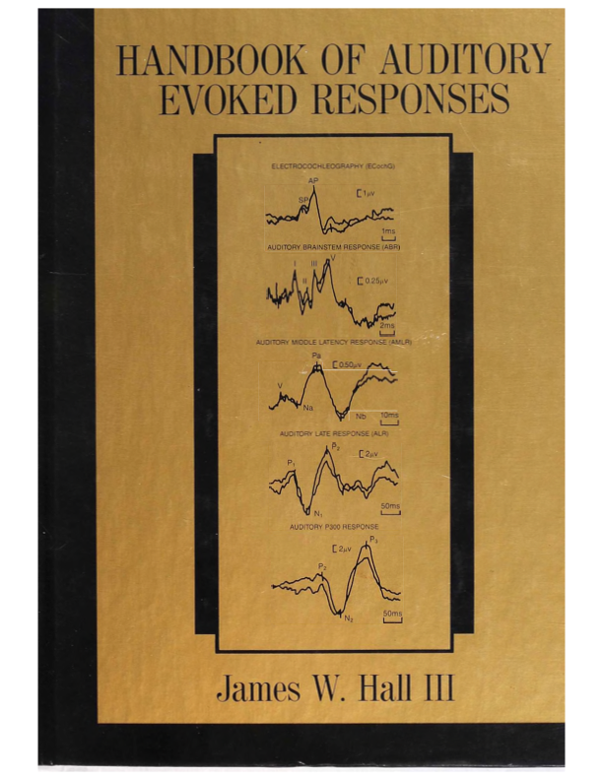
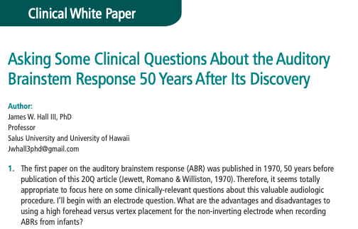
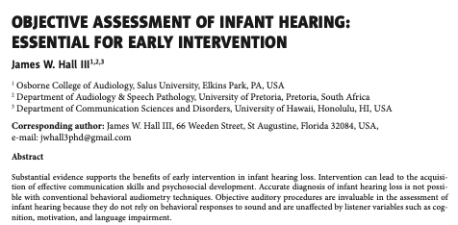
Evidence-Based Objective Assessment of Infant Hearing: Frequency-Specific ABR and More
Handouts (jh4325@drexel.edu)
Journal of Hearing Science, 2016
2020
1992

Slide 4
Evidence-Based Objective Assessment of Infant Hearing: Frequency-Specific ABR and More
9:00 am Introduction and learning objectives
8:45 am Crosscheck principle in pediatric hearing assessment
9:00 am Objective techniques for auditory assessment of infants
9:30 am Frequency-specific ABR measurement
10:30 am Break
10:45 am Live demo of frequency-specific ABR measurement
11:00 am Attendee hands-on ABR measurement activities
12:45 pm Questions & answers
1:00 noon Adjourn

Slide 5
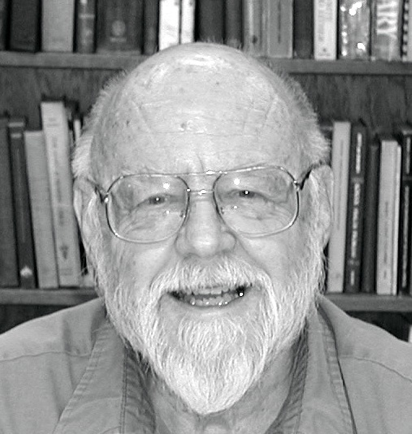

The Cross-Check Principle
(Jerger J & Hayes D. Arch Otolaryngology, 102, 1976)

Slide 6
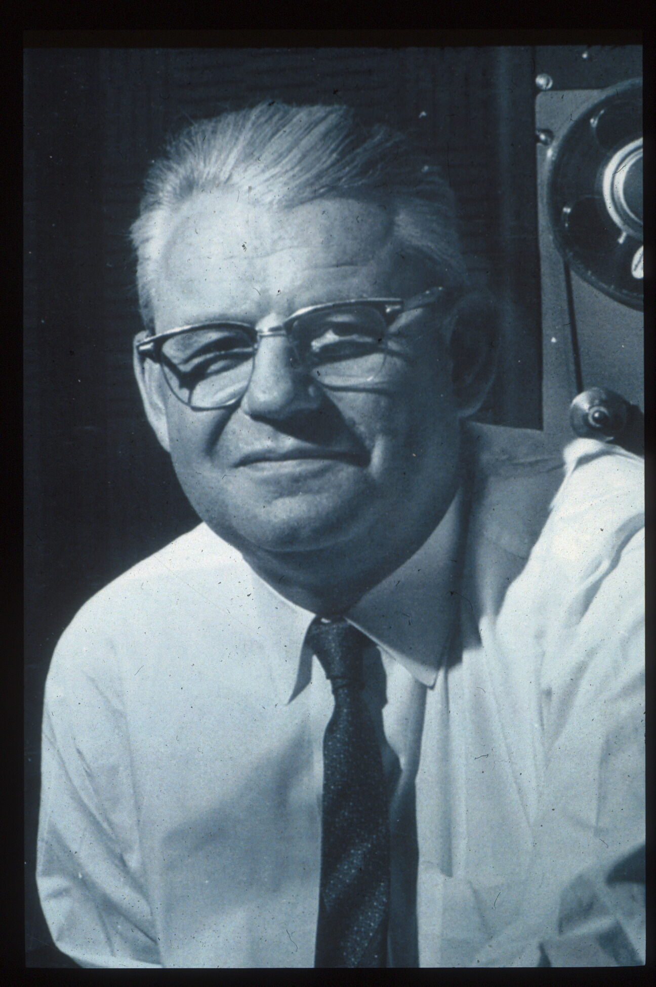
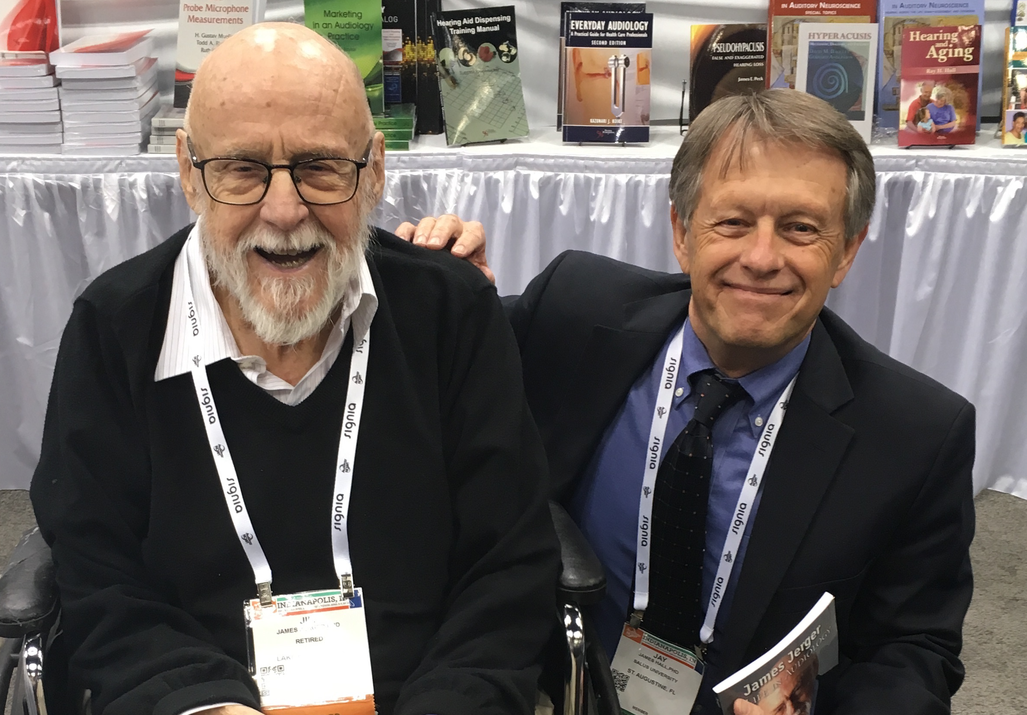
Tribute to James F. Jerger, PhD
(1928 – 2024)
Raymond Carhart

Slide 7
The Cross-Check Principle in Pediatric Audiology
Test Battery in 1976
Behavioral audiometry
  Pure tone audiometry
  Simple speech audiometry
Immittance (impedance) measurements
  Tympanometry
  Acoustic reflexes (contralateral only with SPAR)
Auditory brainstem response (brainstem-evoked response audiometry or BSER)
  Click stimulus (air conduction)
  Click stimulus (bone conduction)

Slide 8
The Cross-Check Principle in Pediatric Audiology
(Jerger J & Hayes D. Arch Otolaryngol 102: 1976)
“We have found than simply observing the auditory behavior of children does not always yield an accurate description of hearing loss”…
“The basic operation of this principle is that no result be accepted until it is confirmed by an independent measure.”
“As long as audiologists are willing to accept the results of a single test measure they will continue to misdiagnosis and mismanage some children.”

Slide 9
Celebrating the 50th Anniversary of The Cross-Check Principle
Current Pediatric Audiology Test Options
Behavioral Audiometry
Otoacoustic Emissions (OAEs)
Aural Immittance Measurements
  Tympanometry
  Acoustic Reflexes (ipsi- and contralateral conditions)
Auditory Brainstem Response (ABR)
  Air- and Bone Conduction Stimulation
  Click, Tone Burst and Chirp Stimulation
Auditory Steady State Response (ASSR)
Electrocochleography (ECochG)
Cortical Auditory Evoked Responses

Slide 10
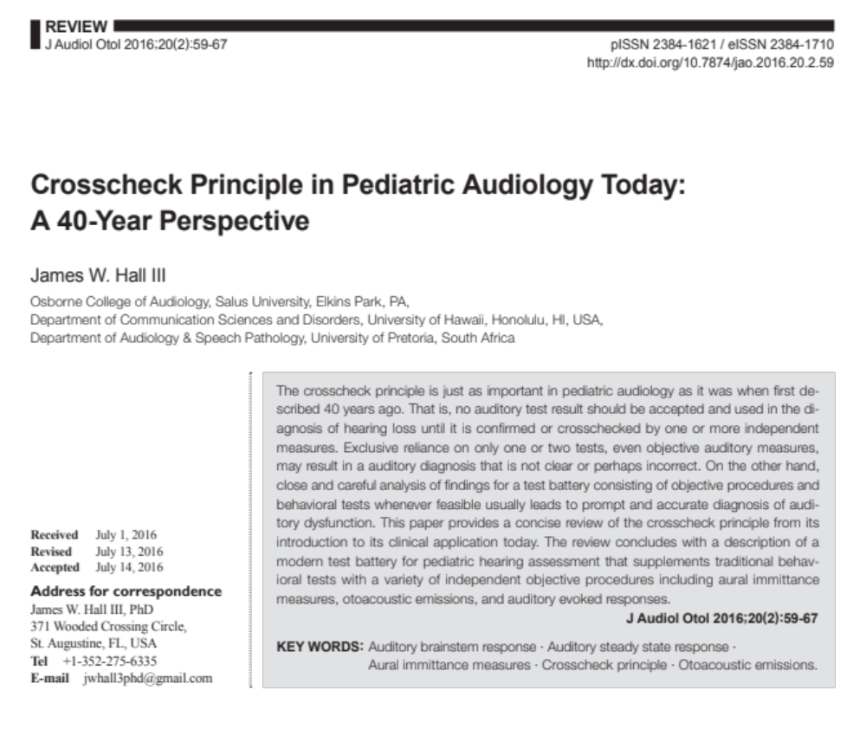
The Cross-Check Principle in Audiology
A 40-Year Perspective
(Request via email)

Slide 11
Evidence-Based Objective Assessment of Infant Hearing: Frequency-Specific ABR and More
Time-Ordered Agenda
9:00 am Introduction and learning objectives
8:45 am Crosscheck principle in pediatric hearing assessment
9:00 am Objective techniques for auditory assessment of infants
9:30 am Frequency-specific ABR measurement
10:30 am Break
10:45 am Live demo of frequency-specific ABR measurement
11:00 am Attendee hands-on ABR measurement activities
12:45 pm Questions & answers
1:00 noon Adjourn

Slide 12
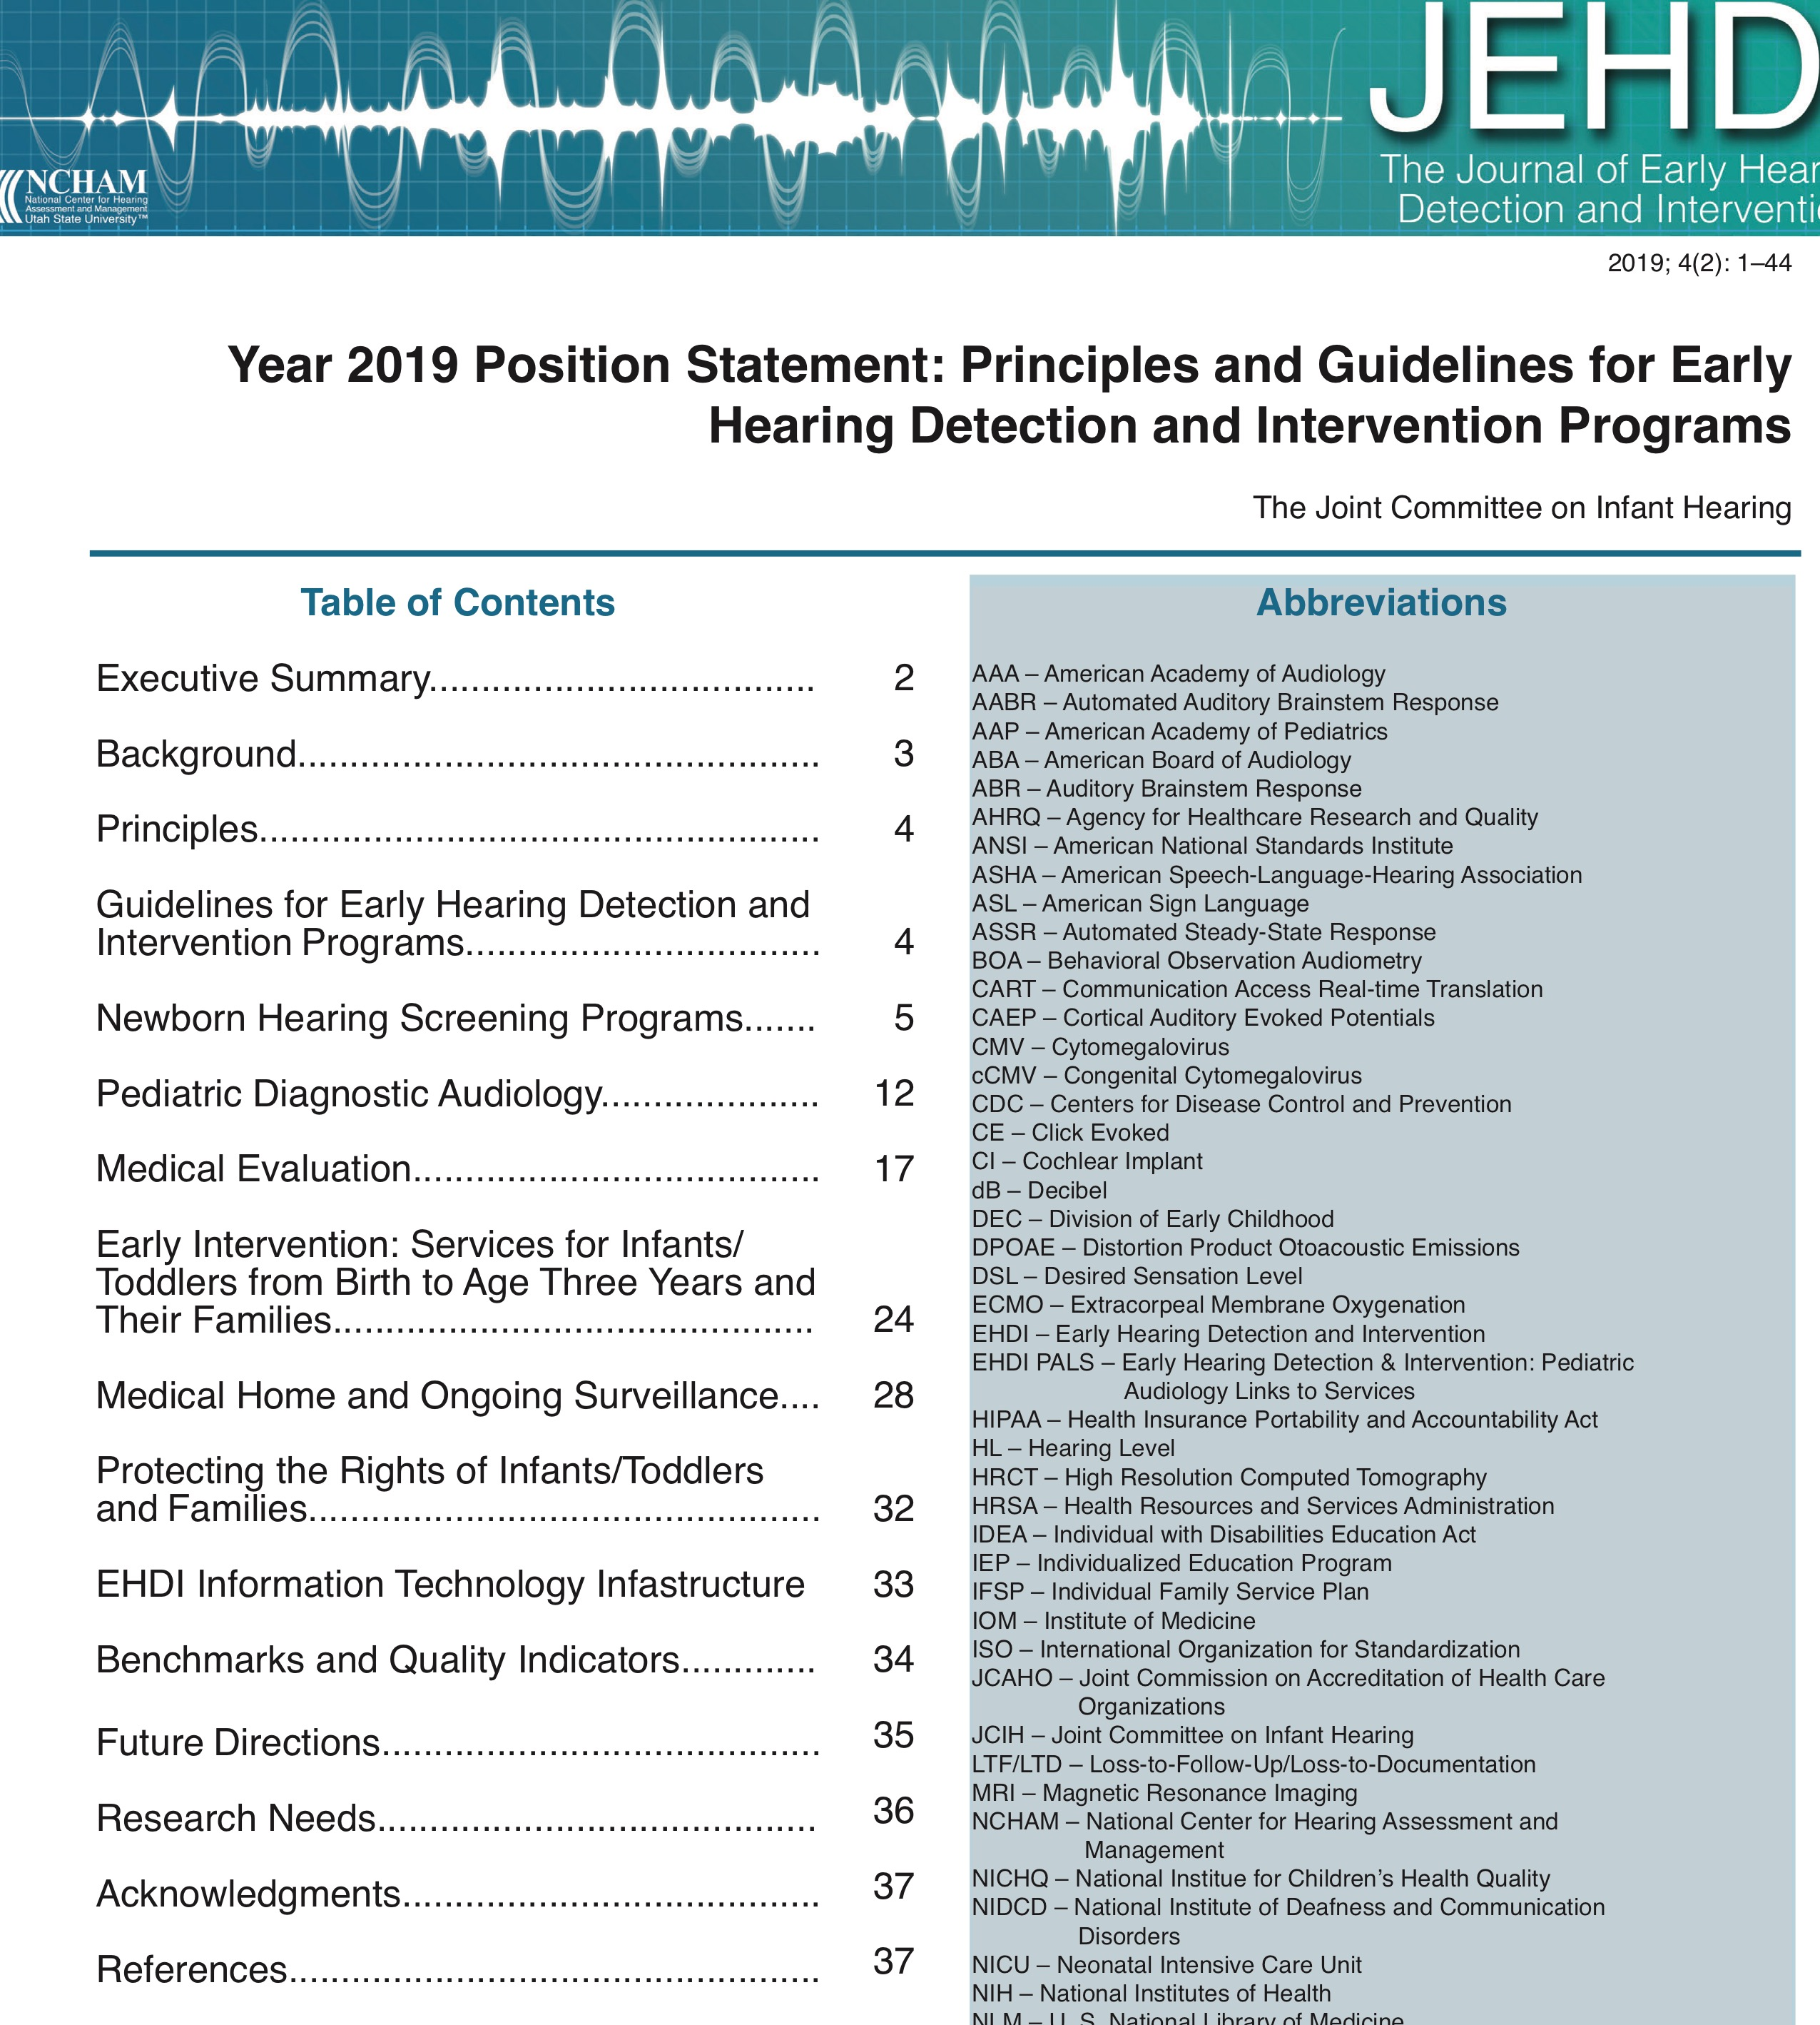
Evidence-Based Objective Assessment of Infant Hearing: Frequency-Specific ABR and More
Objective Auditory Assessment is Standard of Care
Aural immittance measures
  Tympanometry
  Acoustic reflexes
Otoacoustic emissions
Auditory brainstem response
  Air-conduction click stimuli
  Bone-conduction click stimuli
  Tone burst stimuli
  Chirp stimuli
Auditory steady state response

Slide 13
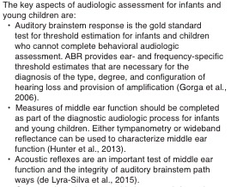
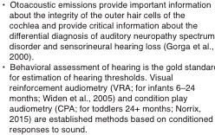
Evidence-Based Objective Assessment of Infant Hearing: Frequency-Specific ABR and More
Aural Immittance Measurement

Slide 14
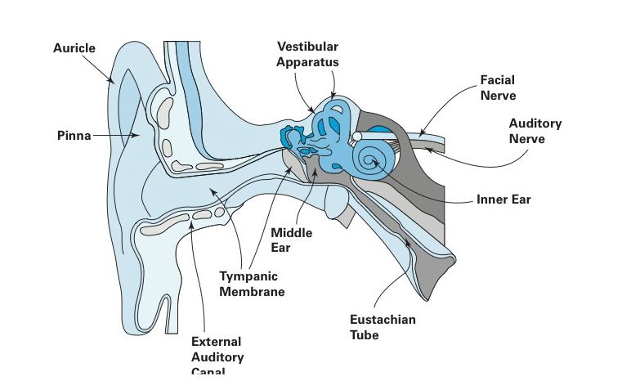
Evidence-Based Objective Assessment of Infant Hearing: Frequency-Specific ABR and More
Aural Immittance Measures
Ear canal volume
Static compliance
Tympanometry
  220 vs. 1000 Hz probe tones for
  adults vs. neonates
  Multiple admittance components
  Middle ear resonance
  Toynbee and Valsalva procedures
  Gradient
  Fistula test
Acoustic reflexes
  Ipsi - and contralateral
  Multiple response parameters

Slide 15
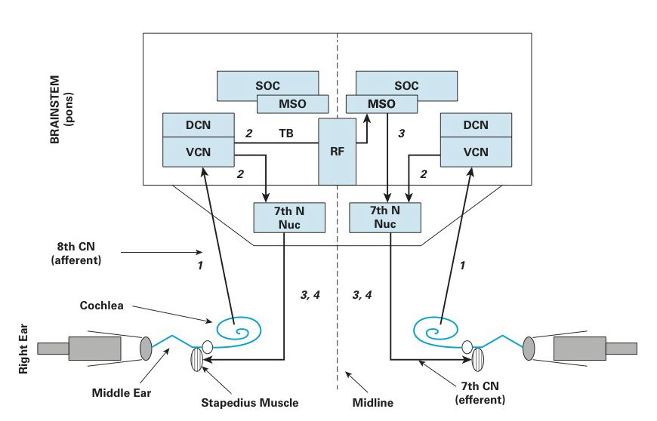
Evidence-Based Objective Assessment of Infant Hearing: Frequency-Specific ABR and More
A Variety of Acoustic Reflex Measurements
Acoustic threshold (ART) or minimum response level
Acoustic reflex amplitude
Acoustic reflex decay
Acoustic reflex latency

Slide 16
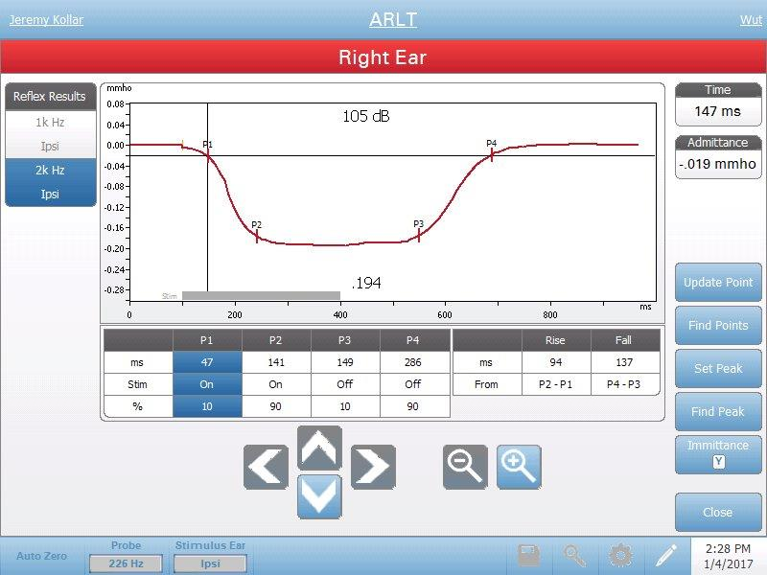
Evidence-Based Objective Assessment of Infant Hearing: Frequency-Specific ABR and More
Acoustic Reflex Latency

Slide 17
Evidence-Based Objective Assessment of Infant Hearing: Frequency-Specific ABR and More
Valuable Acoustic Reflex Applications in Young Children
Detection of even subtle middle ear dysfunction
Normal hearing sensitivity versus sensory hearing loss
Detection of 8th nerve dysfunction
Detection of 7th nerve dysfunction
Detection of brainstem auditory dysfunction
Diagnosis of auditory neuropathy spectrum disorder
Identification of false or exaggerated hearing loss

Slide 18
Simplified SPAR
(Sensitivity Prediction by the Acoustic Reflex)
Hall JW III, Berry GA and Olson K. Identification of serious hearing loss with acoustic reflex data: Clinical experience with some new guidelines. Scandinavian Audiology 11: 251-255, 1982
100
BBN
90
Pure tone signal
ART in dB HL
80
70
0 20 40 60 80
Hearing Loss in dB HL

Slide 19
Evidence-Based Objective Assessment of Infant Hearing: Frequency-Specific ABR and More
Valuable Acoustic Reflex Applications in Young Children
Detection of even subtle middle ear dysfunction
Normal hearing sensitivity versus sensory hearing loss
Detection of 8th nerve dysfunction
Detection of 7th nerve dysfunction
Detection of brainstem auditory dysfunction
Diagnosis of auditory neuropathy spectrum disorder
Identification of false or exaggerated hearing loss

Slide 20


Evidence-Based Objective Assessment of Infant Hearing: Frequency-Specific ABR and More
Valuable Acoustic Reflex Applications in Young Children

Slide 21
Evidence-Based Objective Assessment of Infant Hearing: Frequency-Specific ABR and More
OAE Measurement is Standard of Care

Slide 22
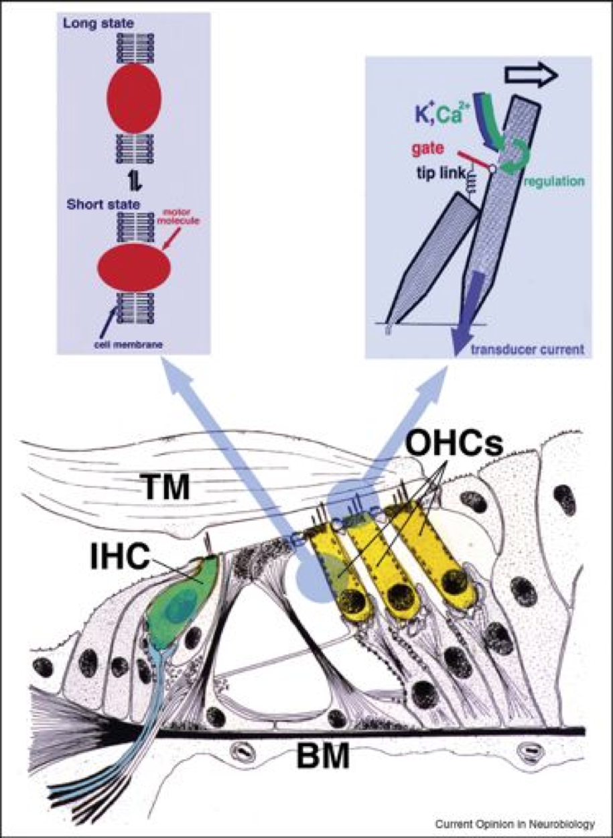
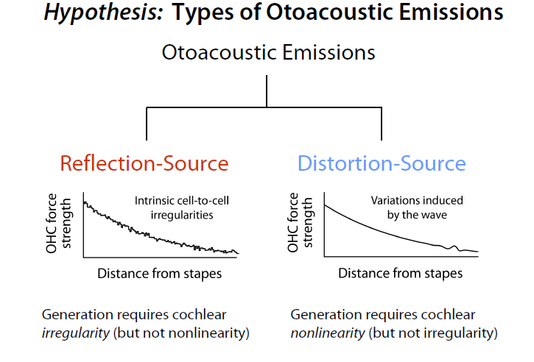
Evidence-Based Objective Assessment of Infant Hearing: Frequency-Specific ABR and More
Anatomy and Physiology of OAEs

Slide 23
Evidence-Based Objective Assessment of Infant Hearing: Frequency-Specific ABR and More
Anatomy and Physiology of OAEs
Outer hair cell motility with prestin motor protein
Stereocilia
Tectorial membrane
Basilar membrane mechanics
Stria vascularis
Middle ear (inward delivery of stimulus and outward propagation of OAE energy)
External ear canal
  Stimulus presentation
  OAE detection

Slide 24
Evidence-Based Objective Assessment of Infant Hearing: Frequency-Specific ABR and More
Four Important Steps Prior to OAE Measurement
Perform otoscopic inspection
Determine risk for middle ear dysfunction
  Patient history
  Conduct tympanometry and acoustic reflexes as indicated to rule out or confirm middle ear dysfunction
Verify stimulus calibration in the patient’s external ear canal
  Actual stimulus levels are in alignment with target stimulus levels (e.g., L2 = 55 dB; L1 = 65 dB)
Confirm low noise levels in the external ear canal
  Less than the 95%ile upper limit for normal subjects

Slide 25
Evidence-Based Objective Assessment of Infant Hearing: Frequency-Specific ABR and More
General Steps in Analysis of OAE Findings
Verify adequately low noise floor (< 90% normal limits)
Perform analysis at all test frequencies
Verify repeatability of TEOAE or DPOAE amplitude (+/- 2 dB) from at least two runs
Is OAE - NF difference > 6 dB?
  Yes? OAEs are present
  No? There is no evidence of OAEs
Is DP amplitude within normal limits?
  Yes? OAEs are normal
  No? OAEs are abnormal (but present)

Slide 26
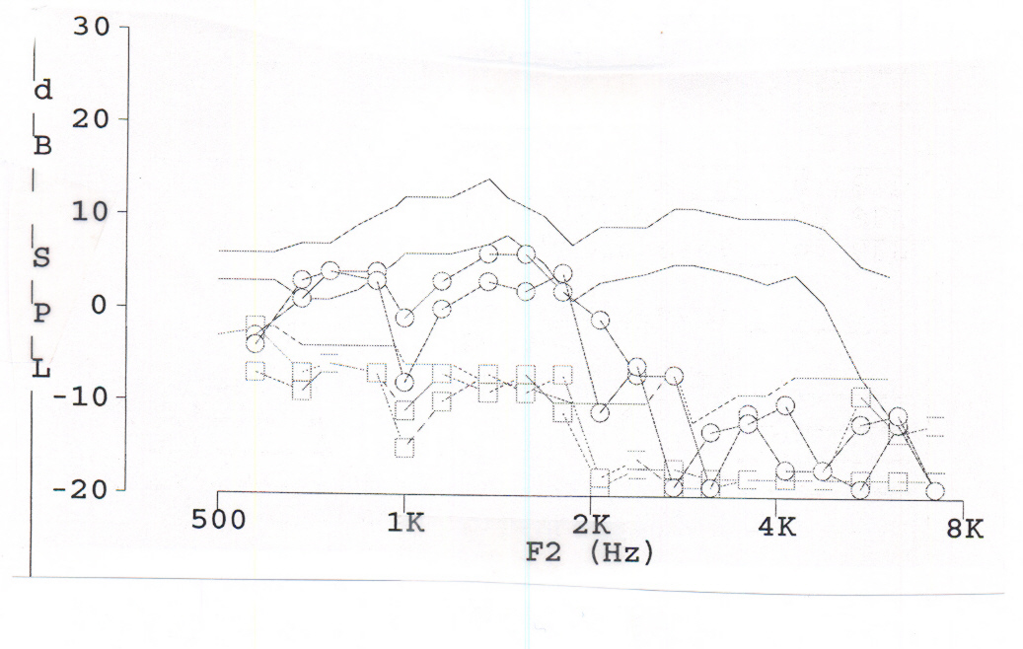
Evidence-Based Objective Assessment of Infant Hearing: Frequency-Specific ABR and More
Analysis of DPOAEs
1. Normal 2. Present but Abnormal 3. Absent
Normal
Present but Abnormal
Normal
Absent (No OAE)

Slide 27
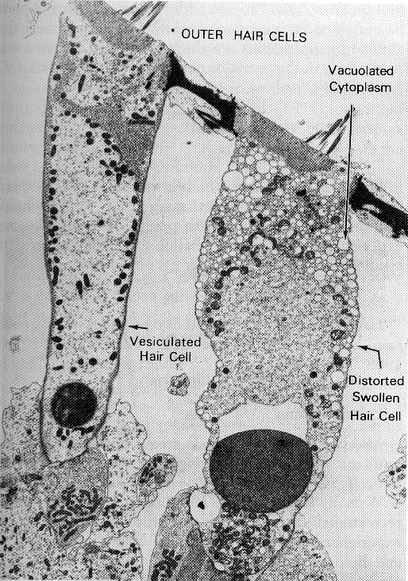
Evidence-Based Objective Assessment of Infant Hearing: Frequency-Specific ABR and More
OAEs in Early Detection of Outer Hair Cell Dysfunction
Normal
OHC
(OAEs)
Abnormal
OHC
(OAEs)

Slide 28
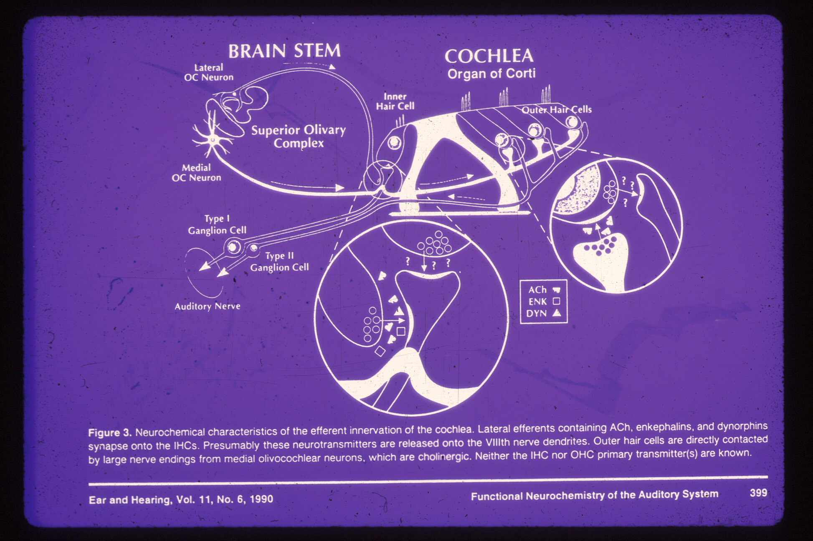
Evidence-Based Objective Assessment of Infant Hearing: Frequency-Specific ABR and More
Generation of OAEs is “Pre-Neural”

Slide 29
Evidence-Based Objective Assessment of Infant Hearing: Frequency-Specific ABR and More
Relation of OAEs to Audiogram
OAEs Audiogram Possible Interpretation
Normal Normal Normal cochlear function
Abnormal Normal > Outer hair cell dysfunction
> Rule out middle ear dysfunction
Normal Abnormal > Technical problems
> Inner hair cell dysfunction
> Neural auditory dysfunction
> False hearing loss

Slide 30
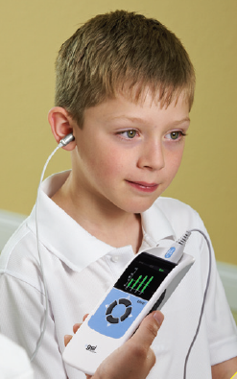
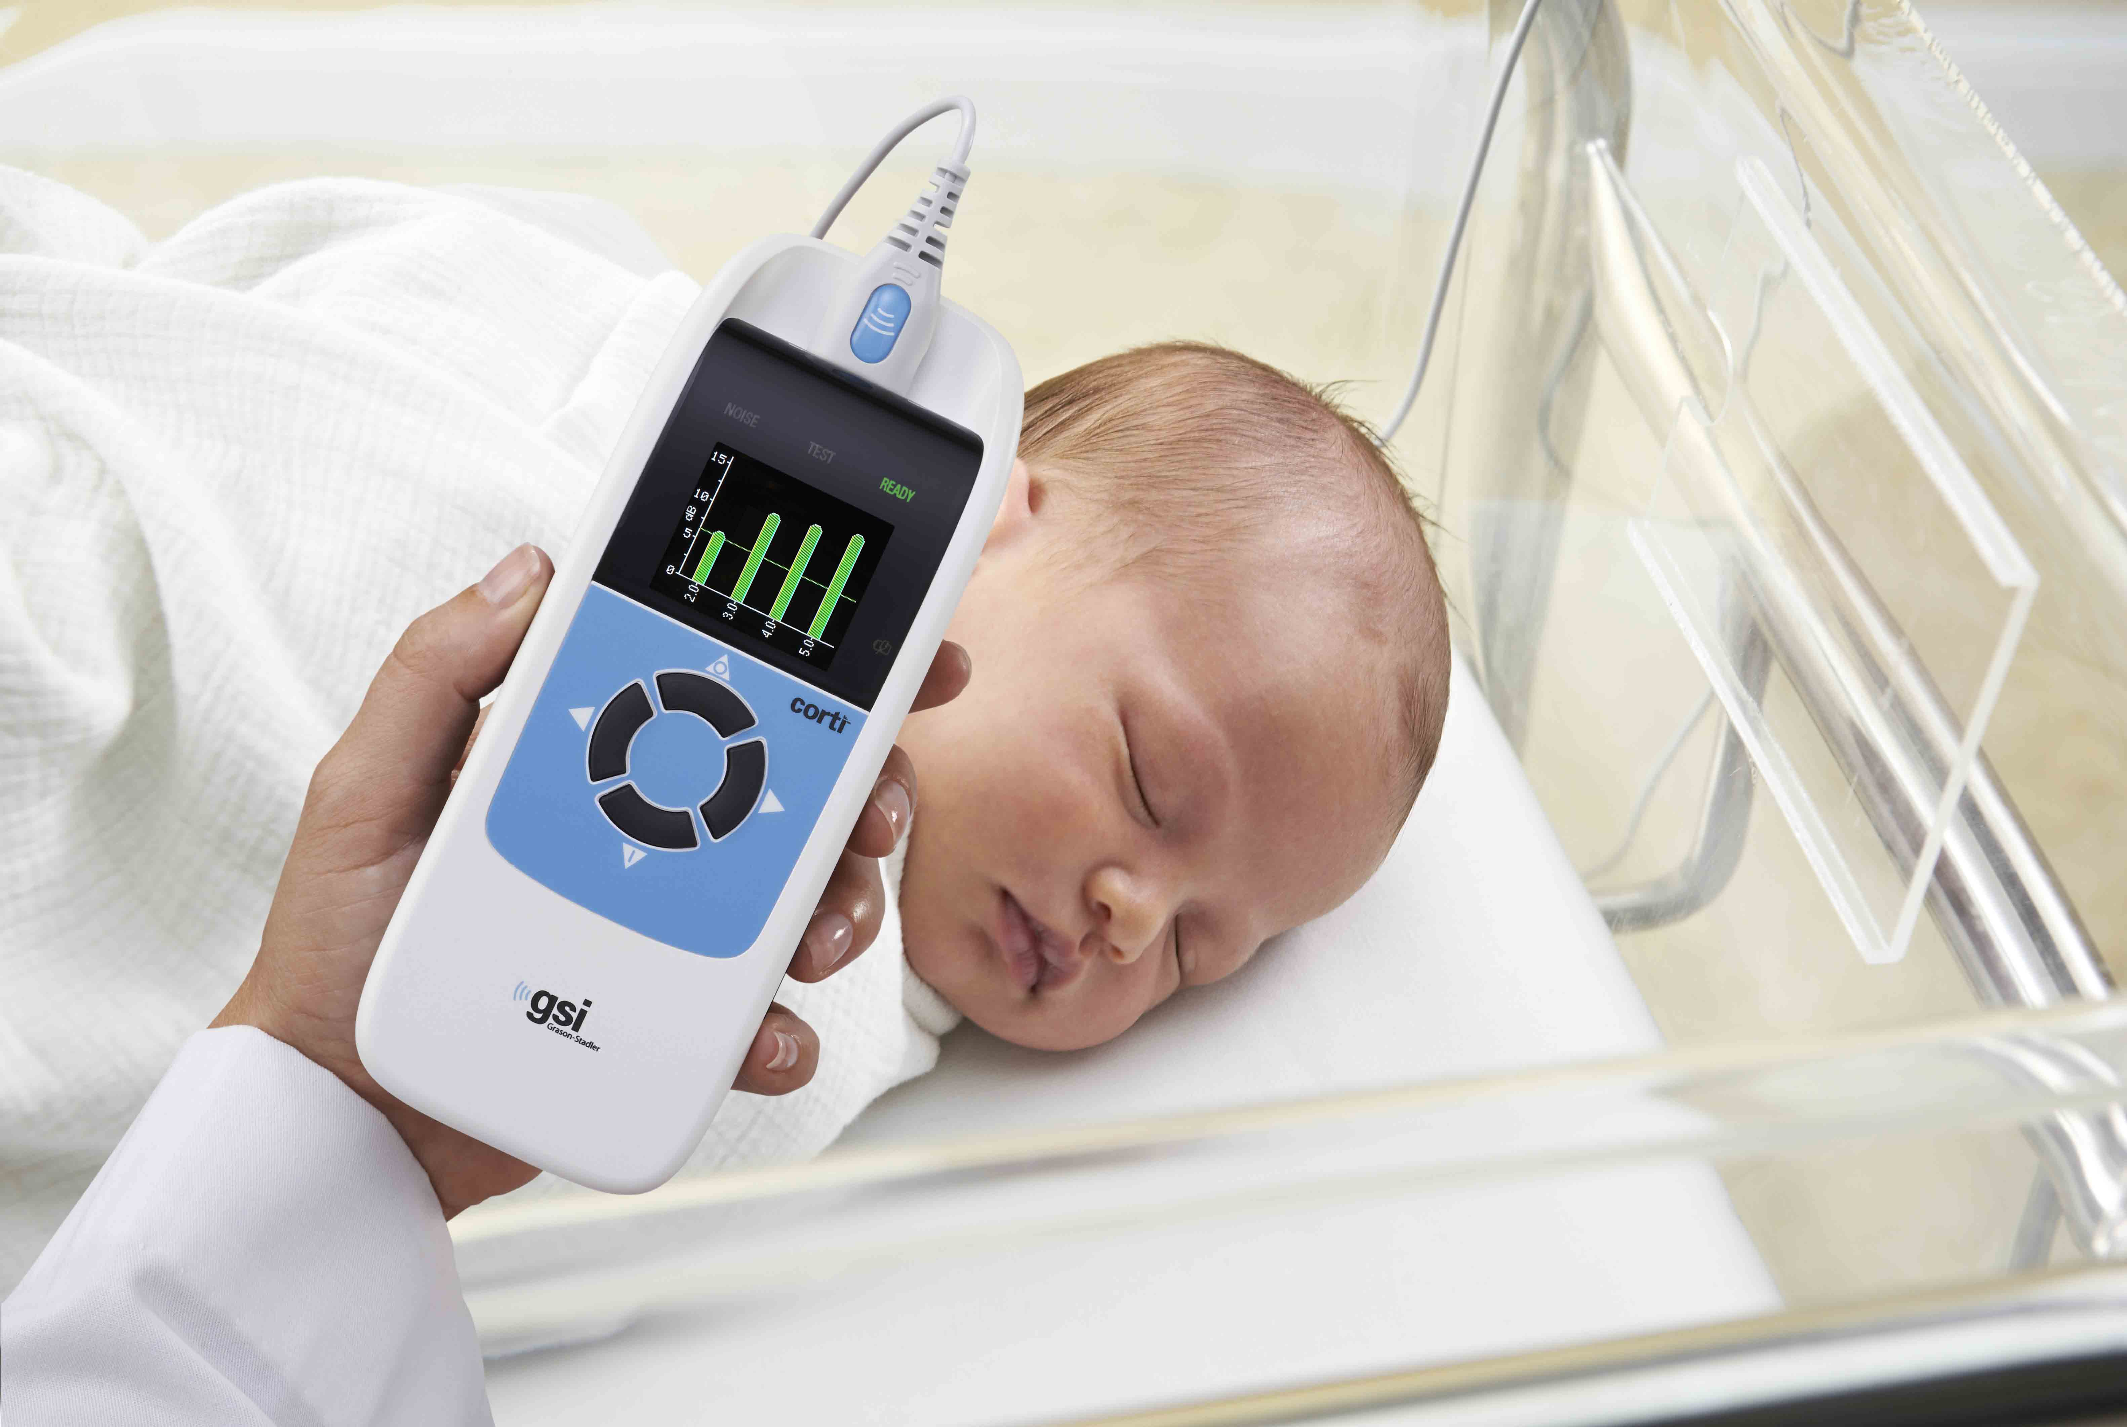
Evidence-Based Objective Assessment of Infant Hearing: Frequency-Specific ABR and More
Selected Clinical Pediatric Applications of OAEs
Infant hearing screening
Diagnosis of auditory dysfunction including ANSD
Monitoring ototoxicity
Pre-school hearing screening
Identification of false or exaggerated hearing loss

Slide 31
Evidence-Based Objective Assessment of Infant Hearing:
Frequency-Specific ABR and More
Minimal Test Battery According to 2010 ANSD Guidelines
Otoacoustic emissions (OAEs)
Cochlear microphonic (CM may be present when OAEs are absent)
Tests of auditory nerve function
ABR for high intensity click stimulation (e.g., 80 to 90 dB nHL) with separate averages for rarefaction stimulus polarity vs. condensation stimulus polarity

Slide 32
Evidence-Based Objective Assessment of Infant Hearing: Frequency-Specific ABR and More
Time-Ordered Agenda
9:00 am Introduction and learning objectives
8:45 am Crosscheck principle in pediatric hearing assessment
9:00 am Objective techniques for auditory assessment of infants
9:30 am Frequency-specific ABR measurement
10:30 am Break
10:45 am Live demo of frequency-specific ABR measurement
11:00 am Attendee hands-on ABR measurement activities
12:45 pm Questions & answers
1:00 noon Adjourn

Slide 33
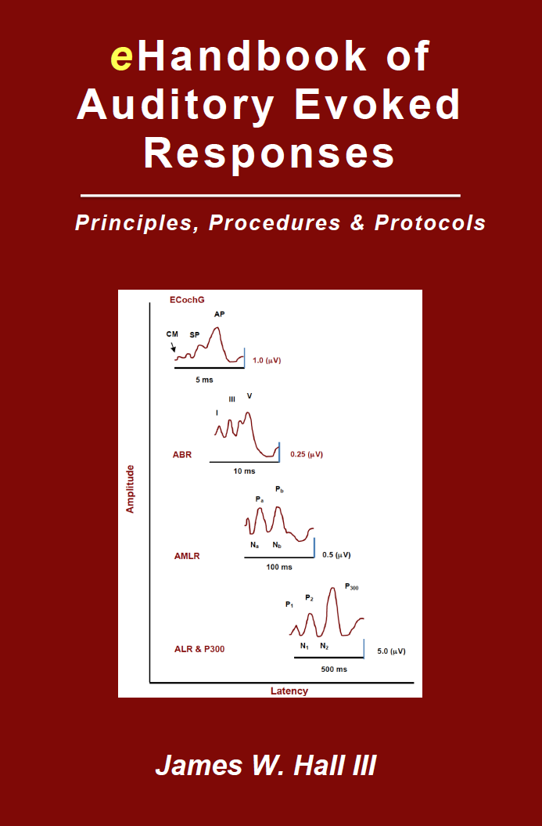
eHandbook of Auditory Evoked Responses
Available from Amazon.com http://www.amazon.com/dp/B0145G2FFM
Chapter 1. Introduction to Auditory Evoked Responses
Chapter 2. Introduction to Electrocochleography
Chapter 3. ECochG: Clinical Populations
Chapter 4. Introduction to Auditory Brainstem Response (ABR)
Chapter 5. ABR: Stimulus Parameters
Chapter 6. ABR: Acquisition Parameters and Test Protocols
Chapter 7. ABR: Analysis and Trouble Shooting
Chapter 8. ABR: Clinical Applications and Patient Populations
Chapter 9. Auditory Steady State Response
Chapter 10. Auditory Middle Latency Response
Chapter 11. Auditory Late Response
Chapter 12. P300 Response and MMN

Slide 34
Evidence-Based Objective Assessment of Infant Hearing: Frequency-Specific ABR and More
ABR Measurement is Standard of Care
Year 2019 Joint Committee on Infant Hearing

Slide 35
Evidence-Based Objective Assessment of Infant Hearing: Frequency-Specific ABR and More
ABR Protocol: Stimulus Parameters
Parameter Selection Comment
Transducer Insert earphones A dozen good reasons
Bone oscillator BC ABR is often necessary
Type Click or tone burst Click for diagnosis
Tone burst for threshold estimation
Duration Click = 0.1 ms Transient (synchronous firing) onset
TB = 2-0-2 cycles Tonal but transient
Polarity Rarefaction Larger amplitude; change as indicated
Rate Click = 21.1/sec Faster rate saves time; slow if necessary
TB = 37.7/sec Faster rate saves time; only need wave V
Intensity Variable in dB nHL High for neurodiagnosis; low for thresholds
Repetitions Variable Whatever is needed for good SNR
Masking Rarely needed Only if ABR is abnormal and no wave I

Slide 36
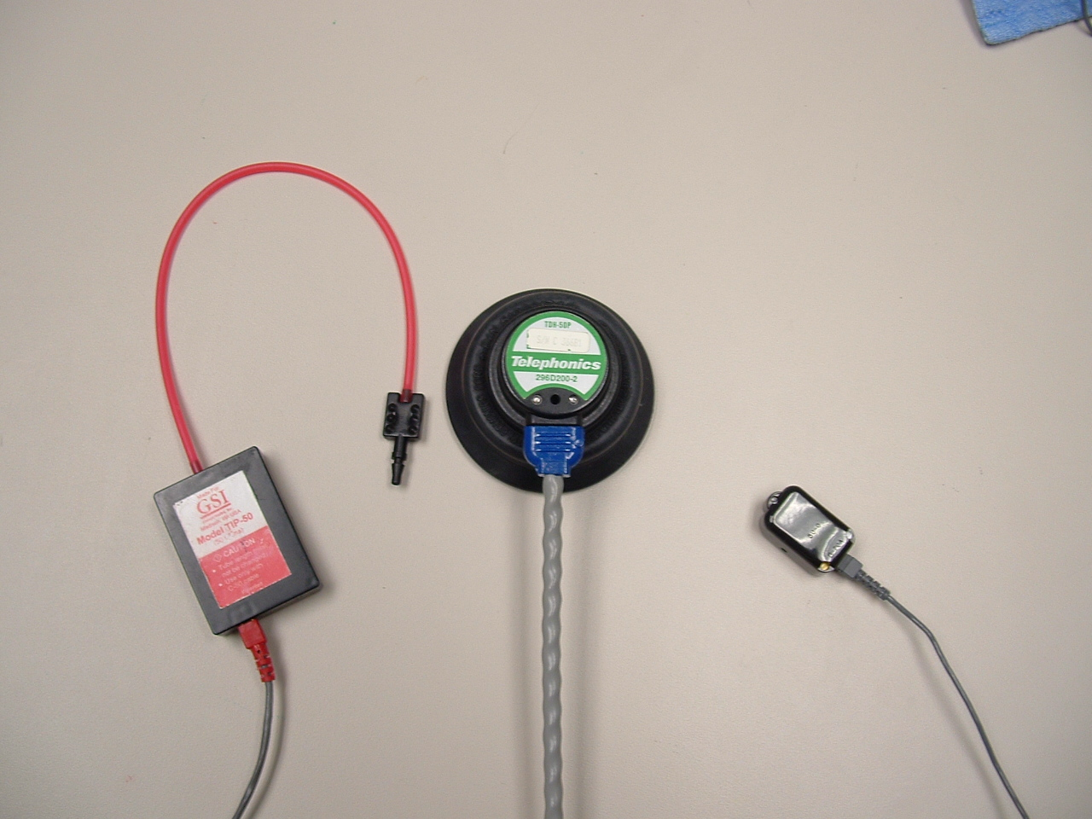
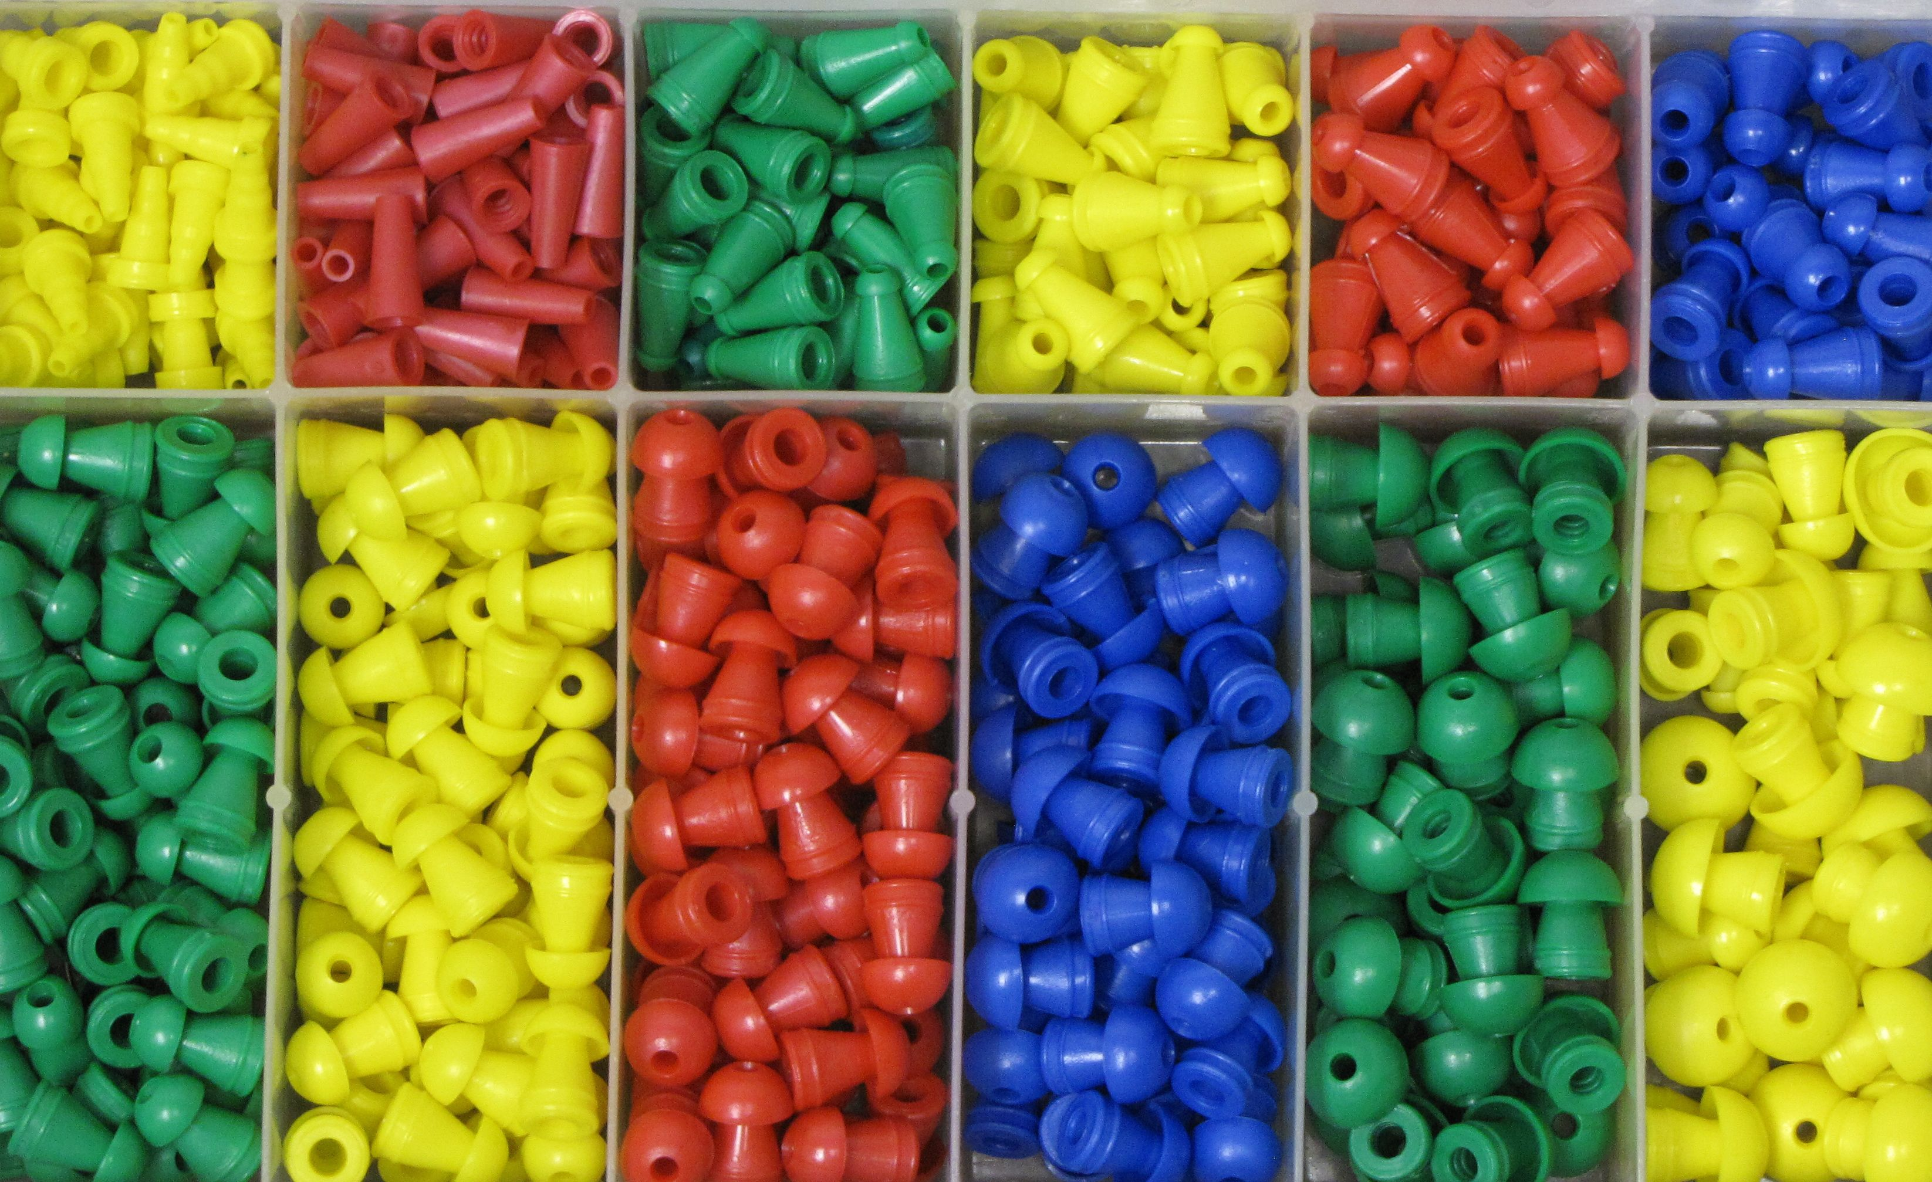
Evidence-Based Objective Assessment of Infant Hearing: Frequency-Specific ABR and More
Advantages of Insert Earphones in ABR Measurement
General
  Increased inter-aural attenuation
  Increased ambient noise attenuation
  Elimination of ear canal collapse
  Increased patient comfort
  Improved infection control
  More precise placement (reliability)
ABR specifically
  Reduced transducer ringing
  Reduced stimulus artifact with separation of transducer from inverting (earlobe) electrode

Slide 37
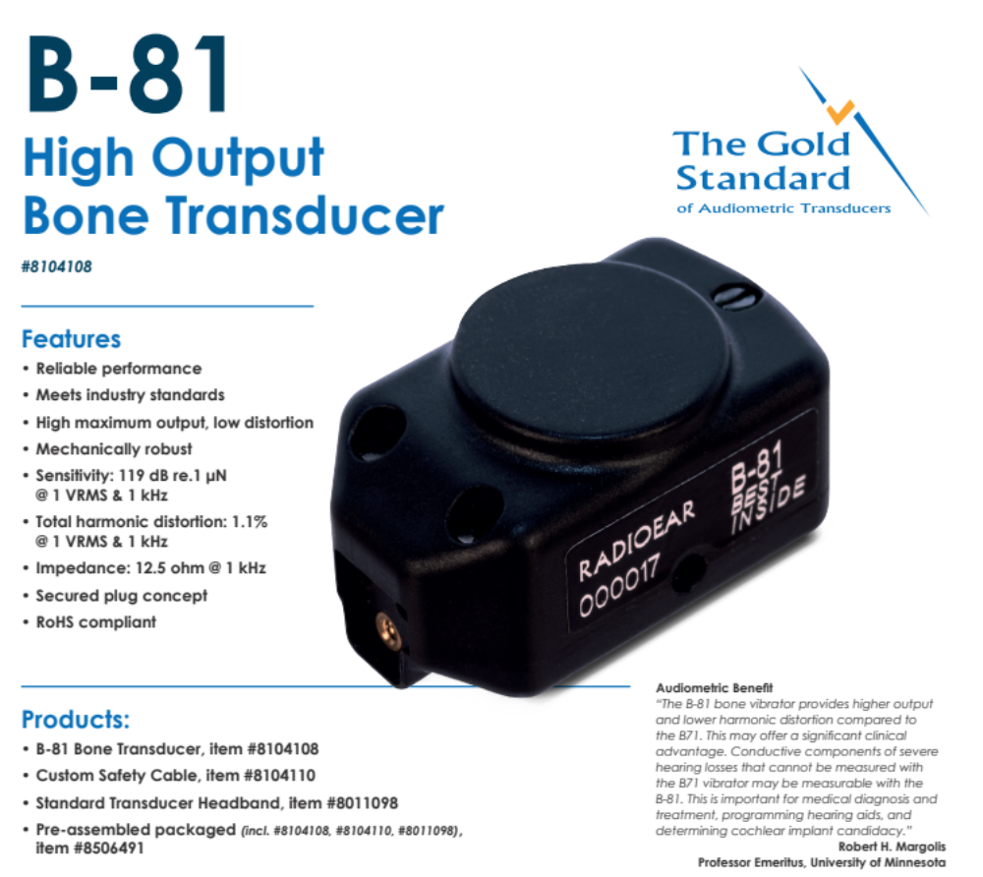
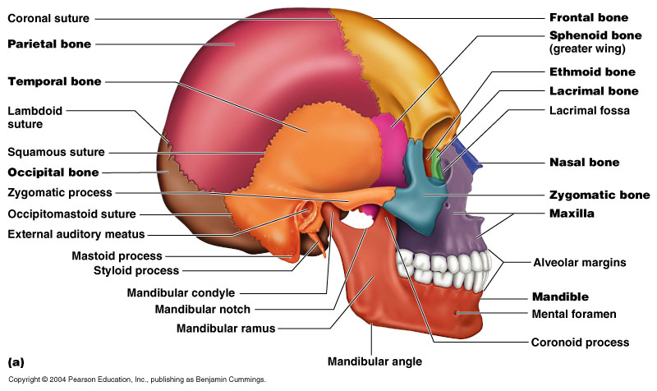
Evidence-Based Objective Assessment of Infant Hearing: Frequency-Specific ABR and More
A Modern Bone Oscillator Design for ABR Recording

Slide 38
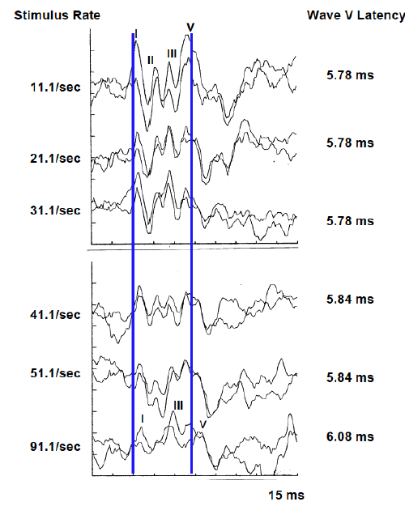
Evidence-Based Objective Assessment of Infant Hearing:
Frequency-Specific ABR and More
What is the Optimal Stimulus Presentation Rate?
General Guideline: Fastest rate that still produces an optimal response
Click stimulus: 21.1/sec
  Extensive normative data for latency
  Slow enough to identify wave I
  Fast enough for rapid data collection
  Odd number not in sync with 50 Hz or 60 Hz current
Tone burst stimulus: 37.7/sec
  Quicker test time
  Not interested in wave I
  No negative impact of rate increase on waveform morphology

Slide 39
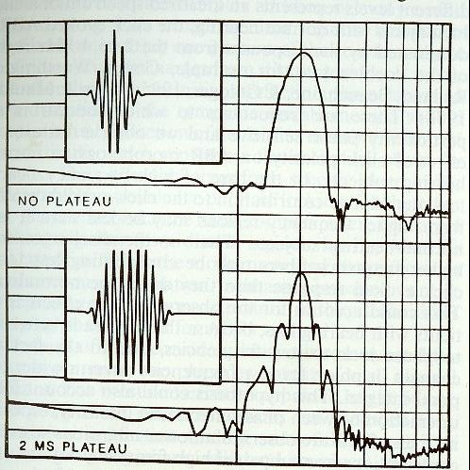
Evidence-Based Objective Assessment of Infant Hearing: Frequency-Specific ABR and More
Effect of Tone Burst Plateau
(Gorga & Thornton, 1989)
Recommended Tone Burst Duration:
2 cycles rise time
0 cycles plateau
2 cycles fall time

Slide 40
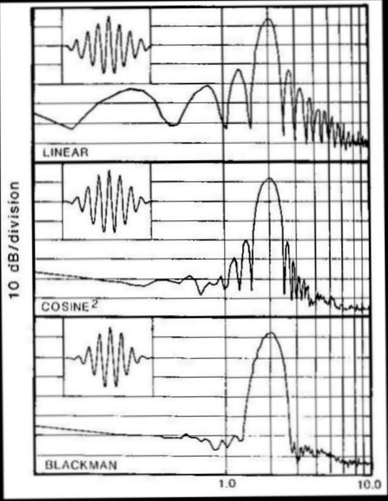
Evidence-Based Objective Assessment of Infant Hearing: Frequency-Specific ABR and More
Effect of Tone Burst Onset Ramp
(Gorga & Thornton, 1989)
Ralph B. Blackman
(1904-1990)
MIT educated mathematician and engineer
Pioneer in digital theory
(along with Claude Shannon, John Tukey, et al)
Employed at Bell Telephone Laboratories
(as was Harvey Fletcher)

Slide 41
Evidence-Based Objective Assessment of Infant Hearing:
Frequency-Specific ABR and More
Use Fastest Feasible Stimulus Presentation Rate
Data Collection in a 1-Channel Pediatric ABR Assessment
  4 stimuli (click + 3 tone burst frequencies)
  4 intensity levels per stimulus
  2 replications per intensity level
  2 ears
  Total = 4 X 4 X 2 X 2 = ~ 64 separate ABR waveforms
Calculated Data Collection Time for a 1-Channel ABR Assessment
  Assume 1000 stimuli (sweeps) per waveform = 64,000 sweeps
  Stimulus rate of 11.1/sec = 96 minutes
  Stimulus rate of 37.7/sec = 28 minutes

Slide 42
Evidence-Based Objective Assessment of Infant Hearing: Frequency-Specific ABR and More
Clinical ABR Concepts for Stimulus Intensity
Transient stimulus intensity is calibrated in dB pe SPL
Intensity is described in dB nHL (normal hearing level)
  0 dB nHL = average behavioral threshold for stimulus
  0 dB nHL is approximately 30 dB peSPL
ABR latency decreases as stimulus intensity increases
  Greatest latency change is for intensity levels < 70 dB nHL
  Flat “latency-intensity function or curve” > 70 dB nHL
Wave V is normally detected within 10 dB of behavioral hearing threshold but not at behavioral threshold
Wave I is usually observed to within about 35 dB of behavioral hearing threshold (smaller amplitude than wave V)

Slide 43
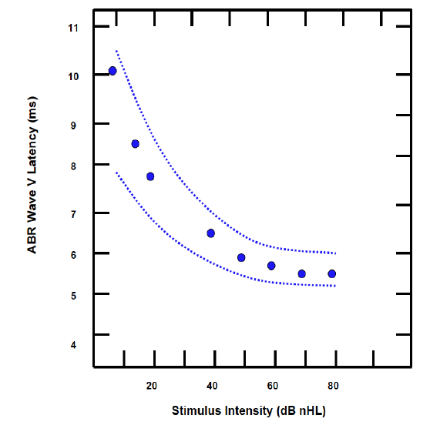
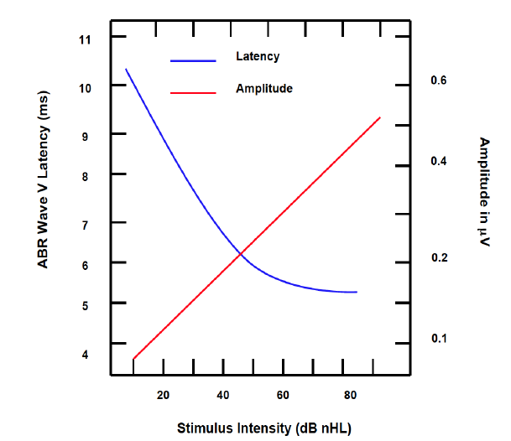
Evidence-Based Objective Assessment of Infant Hearing: Frequency-Specific ABR and More
Effect of Stimulus Intensity on ABR Wave V Latency

Slide 44
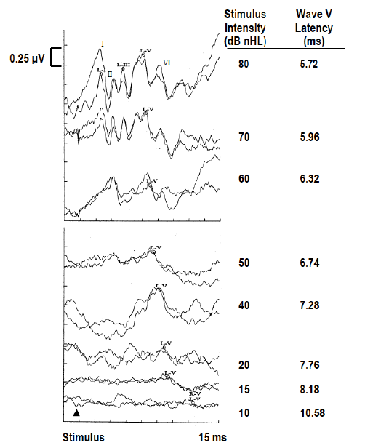
Evidence-Based Objective Assessment of Infant Hearing: Frequency-Specific ABR and More
ABR Wave V Latency versus Intensity
Predictable increase in wave V latency for intensity levels < 70 dB nHL
Decrease in amplitudes of all ABR waves with decreasing stimulus intensity levels
Wave I normally disappears at about 35 dB nHL
Wave V is normally observed
  At lower intensity levels (larger amplitude)
  At an intensity level within 10 dB of behavioral threshold

Slide 45
Evidence-Based Objective Assessment of Infant Hearing: Frequency-Specific ABR and More
ABR Protocol: Acquisition Parameters
Parameter Selection Comment
Channels 1 or 2 One channel is adequate for most applications
Electrodes*
Noninverting Fz Advantages for high forehead vs. vertex
Inverting Ai Ipsilateral earlobe; Problems with mastoid
Ground Fpz Any location is OK for common electrode
Filters
High Pass 30 Hz + Low frequency energy in infant ABR
Low Pass 3000 Hz 2000 or 1500 Hz if there is high frequency artifact
Notch Optional May remove important low frequency energy
Amplification X100,000 Or sensitivity of +/- 25 or 50 mV
Analysis time* ~ 15 ms Encompasses ABR in most recording conditions
Pre-stim baseline - 1 ms Useful information on response quality
Sweeps (# stimuli)* Variable Whatever yields adequate SNR (ABR vs. Noise)

Slide 46
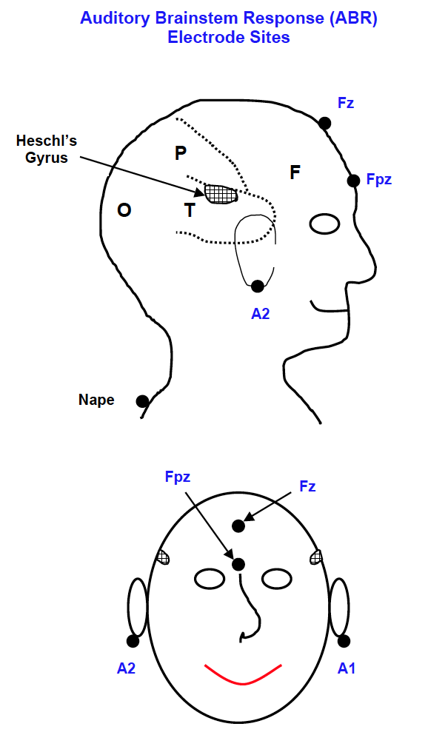
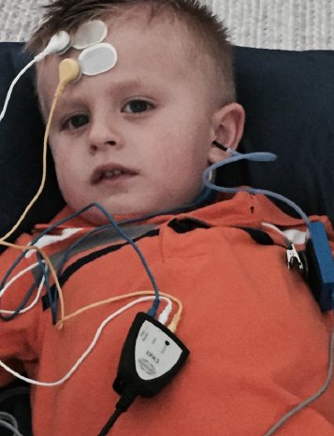
Evidence-Based Objective Assessment of Infant Hearing: Frequency-Specific ABR and More
International 10-20 Electrode System

Slide 47
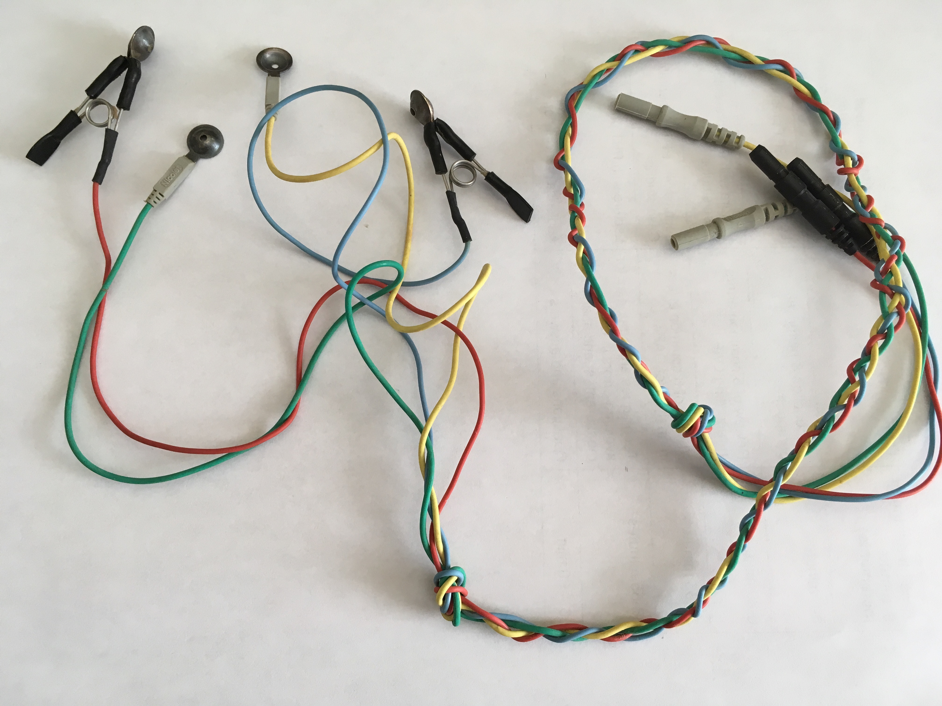
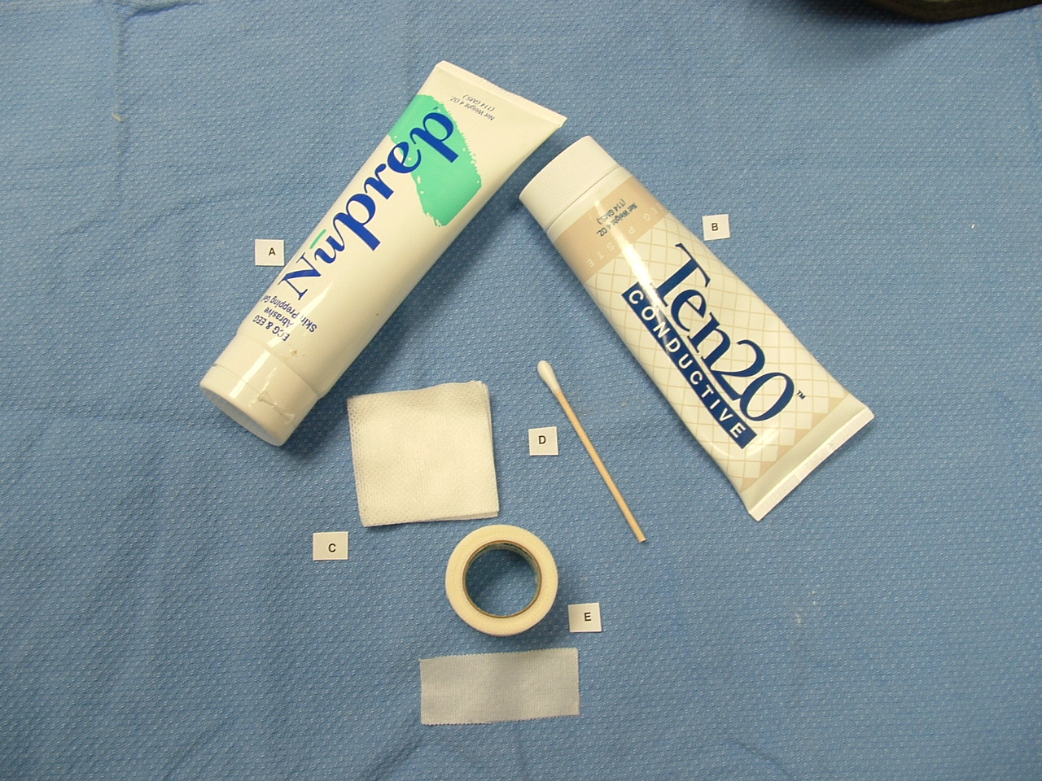
Evidence-Based Objective Assessment of Infant Hearing: Frequency-Specific ABR and More
Electrode Application
Why not use alcohol preps?
Possibility of alcohol intoxication
Less effective in removing old skin and debris
3. Dry and cracked skin on tester (→ infection risk)

Slide 48
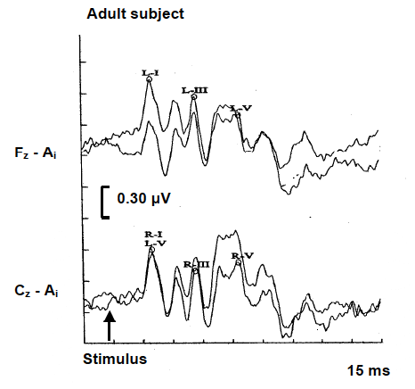
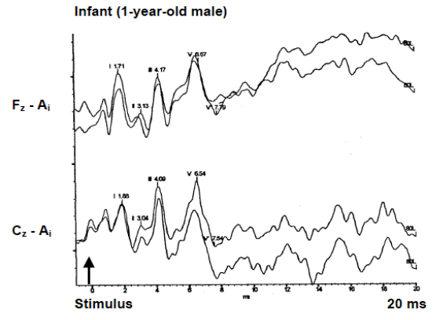
Evidence-Based Objective Assessment of Infant Hearing: Frequency-Specific ABR and More
ABR Measurement: Fz versus Cz Electrode Site
Advantage of Fz versus CZ Placement
More secure attachment (tape versus hair)
Avoid scrubbing fontanelle in newborn infants
3. Avoid bandages and cultural forms of head covering

Slide 49
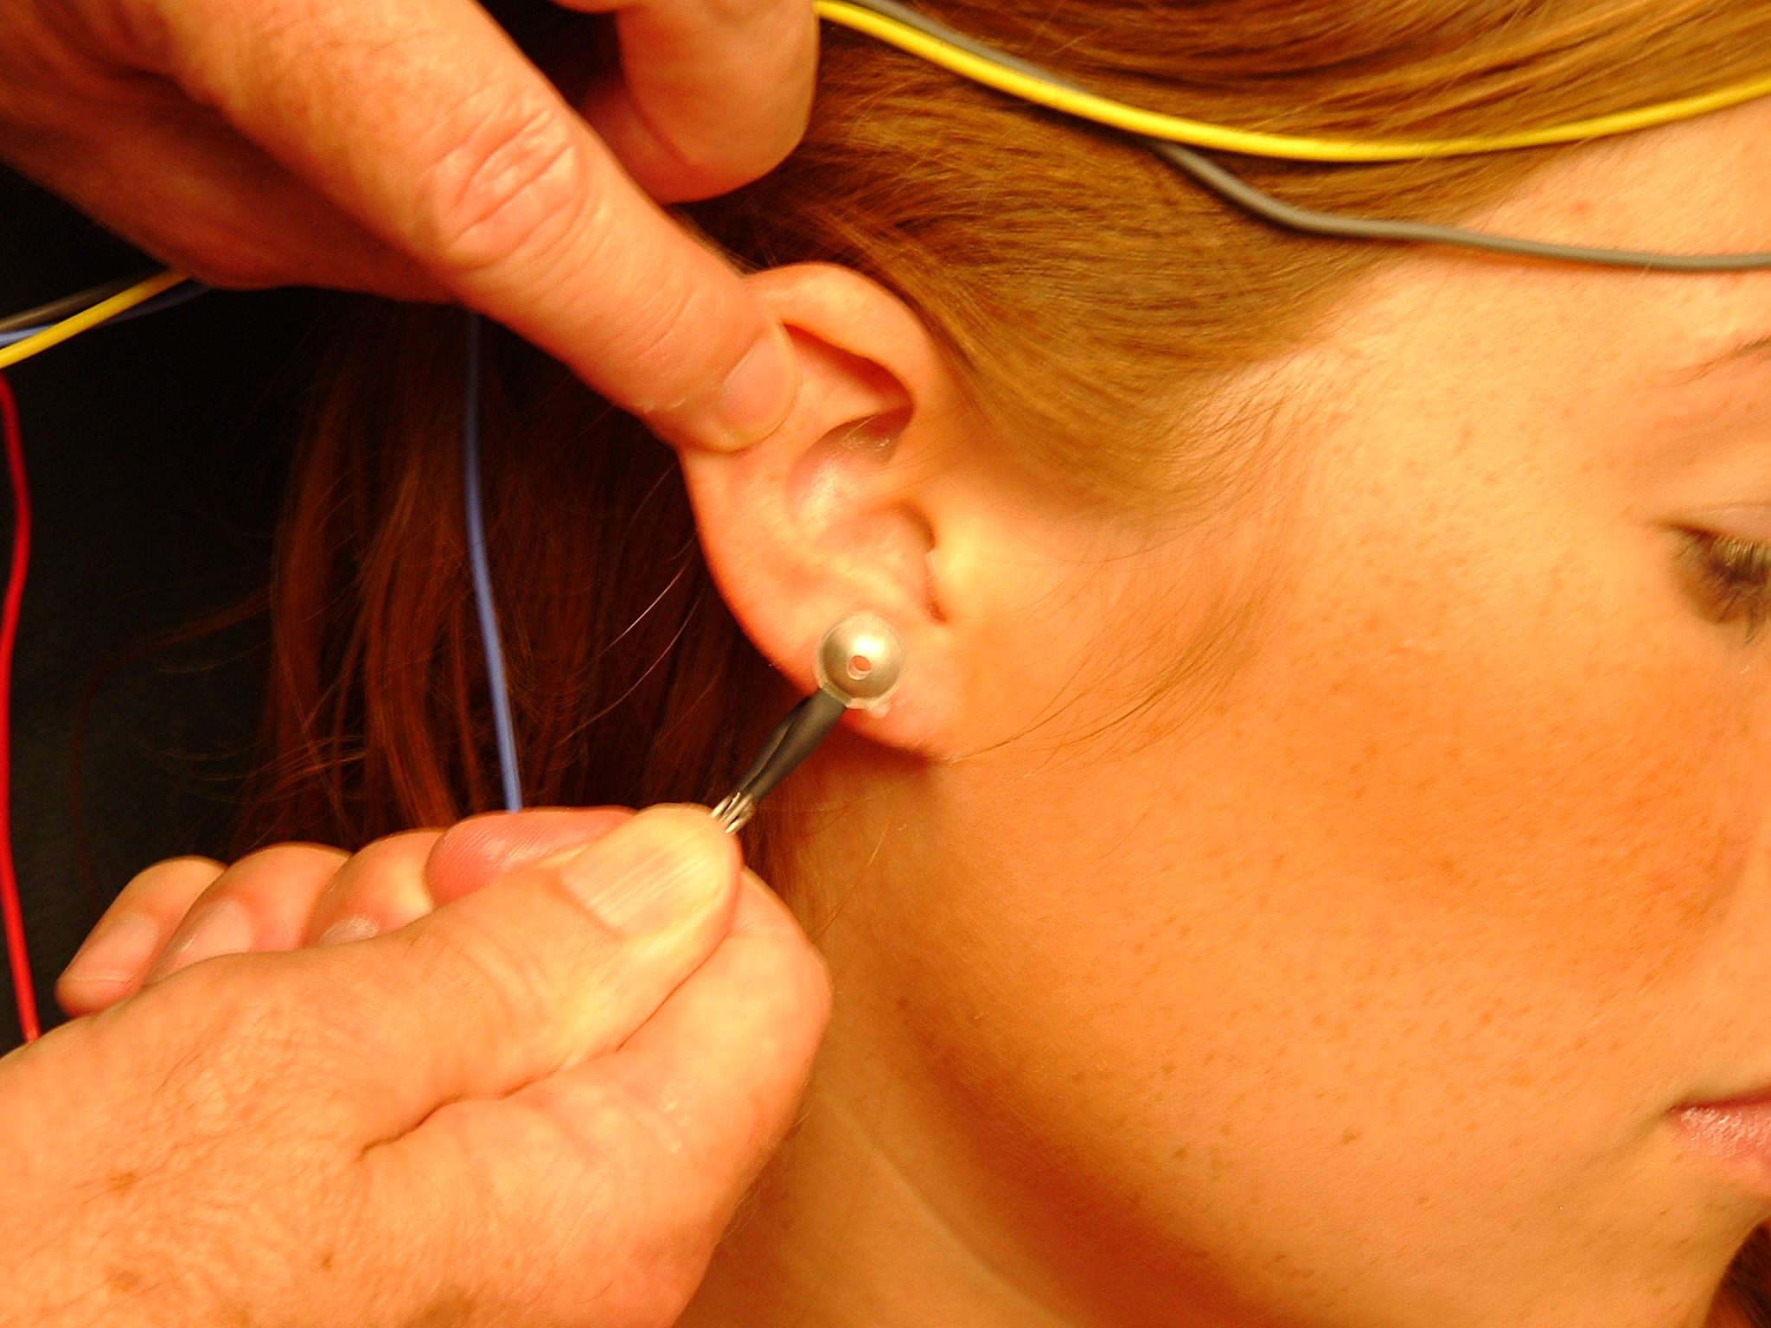
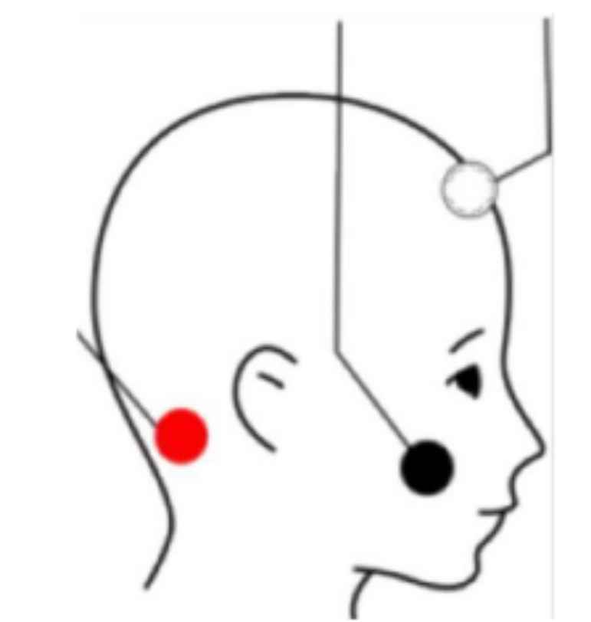
Evidence-Based Objective Assessment of Infant Hearing: Frequency-Specific ABR and More
Advantages for Earlobe vs. Mastoid Inverting Electrode
Advantages of Earlobe versus Mastoid Placement
On average 30% larger wave I amplitude with earlobe
Minimize post-auricular artifact
3. Extend electrode distance from bone oscillator to minimize stimulus artifact

Slide 50
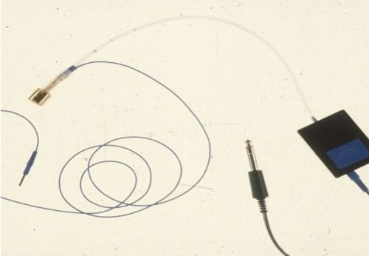
Evidence-Based Objective Assessment of Infant Hearing: Frequency-Specific ABR and More
TIPtrode Electrode Type: Transducer and Electrode
Advantage
Larger wave I amplitude
Clinical Applications
Enhancement of ABR wave I (e.g., neuro-diagnostic ABR)
Diagnosis of ANSD

Slide 51
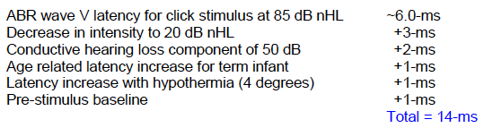
Evidence-Based Objective Assessment of Infant Hearing: Frequency-Specific ABR and More
Factors Affecting Decisions About ABR Analysis Time

Slide 52
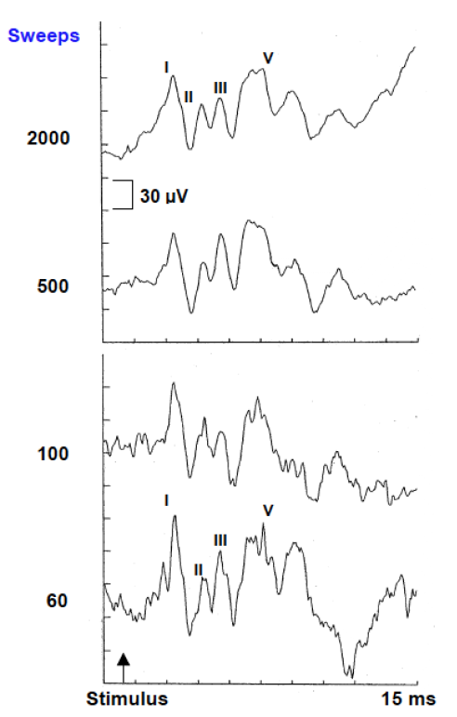
Optimal Number of Stimuli (Signal Averages)
Produces an ABR to Noise Ratio (SNR) of 3:1
Signal-to-noise ratio (SNR) =
Signal Amplitude X Number of Averages
_______________________________
Noise Amplitude
where Signal = ABR and
Noise = any electrical activity that is NOT ABR
Adequate SNR > 3
(ABR wave V is 3 times larger than residual background noise)

Slide 53
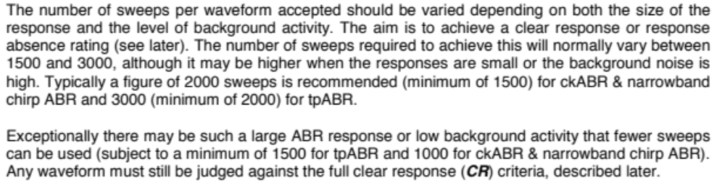
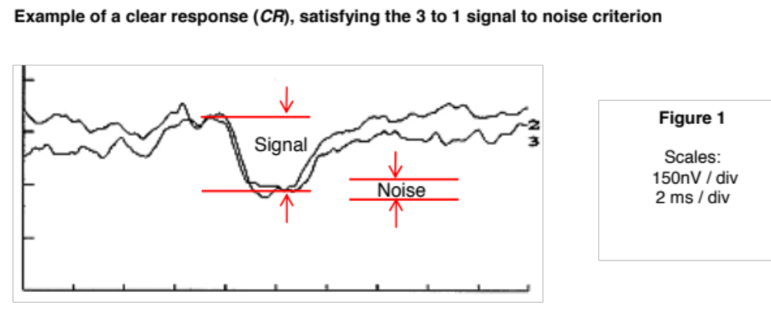
  Avoid Excessive Signal Averaging Despite Adequate SNR
  (NHS Guidelines, 2013)

Slide 54
  Saving Time in Pediatric ABR Measurement
  Avoid Excessive Signal Averaging Despite Adequate SNR
Efficient Data Collection in a Typical Pediatric ABR Assessment:
4 stimuli (click + 3 tone burst frequencies)
4 intensity levels per stimulus
2 ears
500 stimuli (sweeps) per waveform for 3 higher intensity levels
1000 sweeps for two replicated waveforms at threshold intensity level
Total = 1500 + 2000 = 3500 sweeps per stimulus X 4 stimuli X 2 ears = 28,000 sweeps
Calculated Data Collection Time
Assume stimulus rate of 37.7/sec
Averaging of 500 sweeps requires only 13 seconds
Data collection time = 28,000/37.7 = 12.5 minutes
b

Slide 55
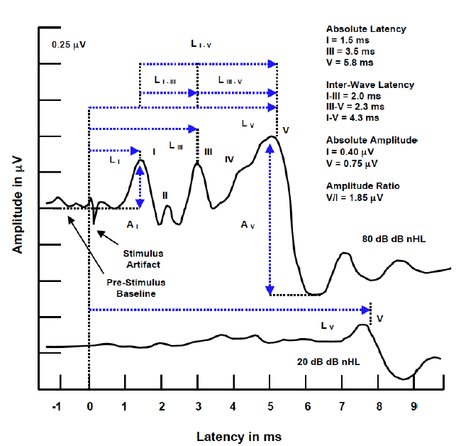
Evidence-Based Objective Assessment of Infant Hearing: Frequency-Specific ABR and More
Analysis of Latency and Amplitude

Slide 56
Evidence-Based Objective Assessment of Infant Hearing: Frequency-Specific ABR and More
Factors Influencing ABR Analysis
Age
  Marked developmental changes
  Modest changes with advanced age
Gender
  Significantly shorter latencies in females versus males
  Use separate normative data for females versus males
Body temperature
  Prolonged latency in hypothermia (0.2 ms/1 degree)
  Shorter latency in hyperthermia
Drugs (medications)
  Sedatives = no effect
  Selected anesthetic agents = slight effect

Slide 57
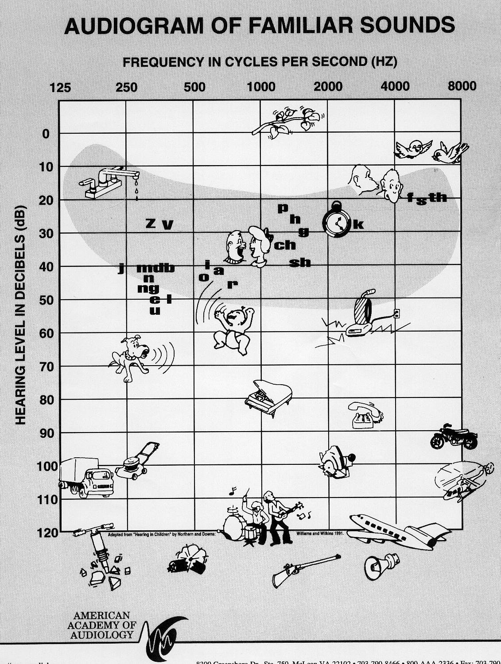
Strengths and Weaknesses of Click-Evoked ABR:
Diagnostically Useful but Limited Frequency-Specificity
Normal click
ABR
Abnormal or
no click
ABR

Slide 58
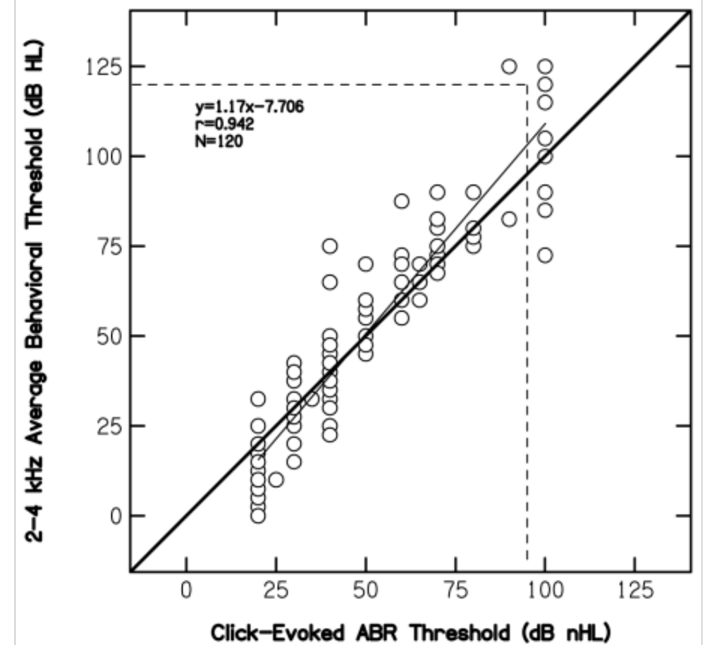
Click-Evoked ABR Correlation with Audiometric Thresholds in the 2000 to 4000 Hz Region
Gorga et al (2006)
Click ABR Threshold versus
Pure Tone Hearing Threshold
(2 to 4 K Hz)
N = 77
71 = < 5 years
Click ABR Threshold
Better Than
Pure Tone Threshold

Slide 59
Click versus Tone Burst ABRs:
3 Differences in Morphology and Latency
1. Smoother waves; 2. Wave I disappears; 3. Latency increases
I
III
V
click
I
III
V
1000 Hz
V
500 Hz
Stimulus
15 ms
Analysis Time

Slide 60
Correction Factors for Converting ABR Thresholds in dB nHL to Estimated Behavioral Thresholds in dB HL (or EHL)
Normal Hearing Patients
Source 500 Hz 1000 Hz 2000 Hz 4000 Hz
BCEHP -15 dB -10 dB -5 dB 0 dB
Bagatto (2006) -20 dB -15 dB -10 dB -5 dB
Hall (2007) -15 dB -10 dB -10 dB -5 dB
Note: According to Stapells (2000), ABR thresholds “overestimate” behavioral thresholds by 10 to 20 dB for normal hearers and 5 to 15 dB for patients with sensory hearing loss

Slide 61
Correction Factors for Converting ABR Thresholds in dB nHL to Estimated Behavioral Thresholds in dB HL (or EHL)
Sensory Hearing Loss
Study 500 Hz 1000 Hz 2000 Hz 4000 Hz
Stapells (2000) +6 dB +5 dB +1 dB -8 dB
(+/-14) (+/-14) (+/-11) (+/-12)
Lee (2008) +5 dB 0 dB -5 dB -5 dB
(+/-5) (+/-5) (+/-8) (+/-8)
Vander Werff +13 dB 0 dB -3 dB
et al (2009) (+/-12) (+/-9) (+/-14)

Slide 62
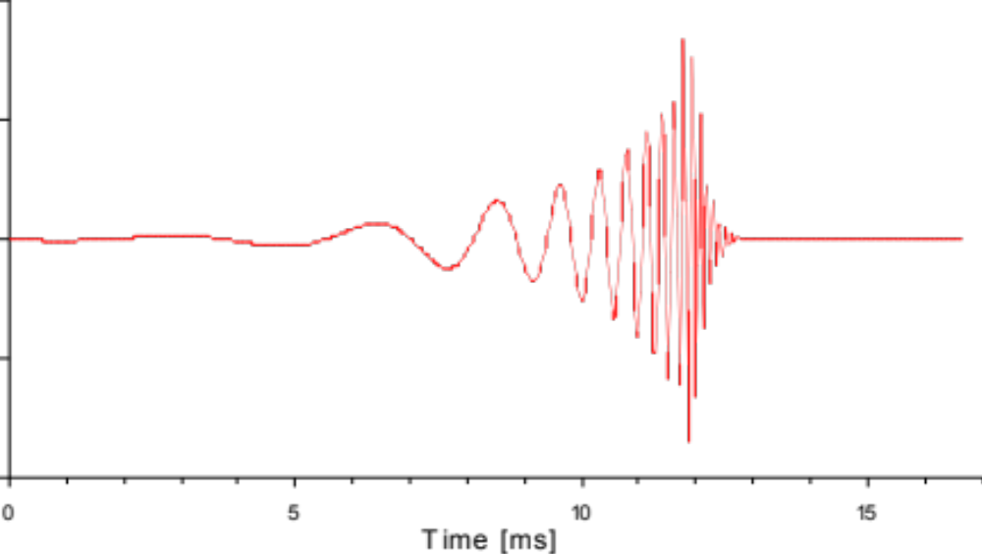
Evidence-Based Objective Assessment of Infant Hearing: Frequency-Specific ABR and More
Temporal Compensation in Chirp Stimulus
Low Frequencies
High Frequencies

Slide 63
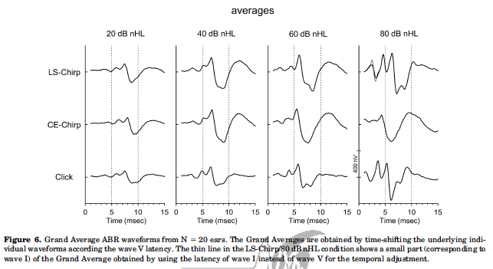
Evidence-Based Objective Assessment of Infant Hearing: Frequency-Specific ABR and More
Chirp Evoked ABR Amplitude is Larger
Larger amplitudes for wave I and V (up to twice as large)
More confident identification of ABR
Detection of clear ABR in less than ideal noise conditions
Possibility of more accurate ABR threshold
Quicker ABR test time (higher signal increases SNR )

Slide 64
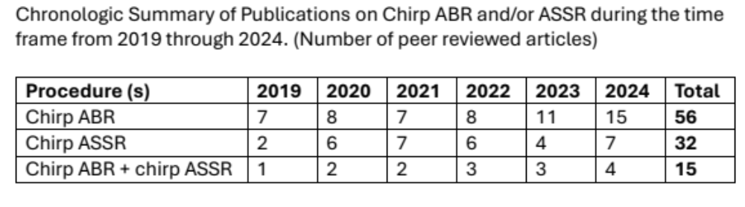
Evidence-Based Objective Assessment of Infant Hearing: Frequency-Specific ABR and More
Growing Research Literature for Chirp Stimulus

Slide 65
Evidence-Based Objective Assessment of Infant Hearing: Frequency-Specific ABR and More
Ear Specific Bone Conduction ABR

Slide 66


Experience with Bone Conduction ABR in
Diagnosing Conductive Hearing Loss in Children

Slide 67
Air- versus Bone Conduction Click Evoked ABR:
Differentiation of Conductive vs. Sensory Hearing Loss
From Hall JW III. Introduction to Audiology Today. Boston: Pearson, 2014

Slide 68

Two-Channel Bone Conduction ABR Recording:
Applying ECochG Principles to Verify the Test Ear
Ipsi Channel
Wave I
Contra Channel
No Wave I

Slide 69

Evidence-Based Objective Assessment of Infant Hearing: Frequency-Specific ABR and More
Bone Conduction ABR is Standard of Care
Year 2019 JCIH Position Statement

Slide 70
Evidence-Based Objective Assessment of Infant Hearing: Frequency-Specific ABR and More Estimation of Air-Bone Gap with ABR
Air conduction
Bone conduction
8
35 dB
Wave V Latency in msec
6
4
0
20
40
60
80
100
Click Intensity in dB nHL

Slide 71




Evidence-Based Objective Assessment of Infant Hearing: Frequency-Specific ABR and More
Sources of “Noise” in ABR Measurement
500
250
125
60
30
0
ECG
EOG (ENG)
60 Hz
Power line noise
Rectified RF noise
EEG sleep
µV
EMG
EEG awake
ABR
Amplitude 0.1 – 1 μV
Frequencies 30 – 3000 Hz
0 10 20 40 80 100 250 500 1000 2000 4000 Hz

Slide 72



Strategies for Enhancing a Quiet Patient State
Three Options for Pediatric ABR Assessment
Natural Sleep
General Anesthesia
Sedation

Slide 73

Evidence-Based Objective Assessment of Infant Hearing: Frequency-Specific ABR and More
ABR with Natural Sleep, Melatonin and Sedation
2025 Audiology Research
Excellent review
Natural sleep: average duration of 49 minutes
Conscious sedation
  Chloral hydrate
  Triclofos (banned in US)
  Midazolam
  Dexmedetomidine (DEX)
  Clonodine
2025

Slide 74

Evidence-Based Objective Assessment of Infant Hearing:
Frequency-Specific ABR and More
Sleep Deprivation in ABR Measurement
Detailed instructions for parents/caregivers
Atypically late bedtime
Extra adult during transportation to clinic
Schedule ABR for first appointment in morning
Prepare for ABR immediately upon patient arrival at clinic
Record ABR after feeding

Slide 75

Evidence-Based Objective Assessment of Infant Hearing: Frequency-Specific ABR and More
Anesthesia as an Option in ABR Assessment of Children
Propofol

Slide 76


Evidence-Based Objective Assessment of Infant Hearing: Frequency-Specific ABR and More
References for More Information
eBook 2015
(Amazon.com)
2018
(Plural Publishing)
Hardcopy or Kindle Version
(www.amazon.com)

Slide 77
Evidence-Based Objective Assessment of Infant Hearing: Frequency-Specific ABR and More
Time-Ordered Agenda
9:00 am Introduction and learning objectives
8:45 am Crosscheck principle in pediatric hearing assessment
9:00 am Objective techniques for auditory assessment of infants
9:30 am Frequency-specific ABR measurement
10:30 am Break
10:45 am Live demo of frequency-specific ABR measurement
11:00 am Attendee hands-on ABR measurement activities
12:45 pm Questions & answers
1:00 noon Adjourn

Slide 78
Hands-on Activities:
Click-Evoked ABR (Air Conduction)
Assembly test supplies (e.g., electrodes, ear tips, etc.)
Create an air conduction click ABR protocol
Instruct subject about test procedure
Select an appropriate size probe tip
Prepare subject for electrode placement
Affix and plug in electrodes
Check inter-electrode impedance
Insert ear tips
For each ear, record replicated ABR waveforms at > 80 dB nHL with rarefaction and condensation polarity stimuli
Terminate signal averaging when ABR wave V amplitude to noise ratio = > 3
Quickly estimate click ABR threshold
Analyze ABR findings

Slide 79


Hands-on Activities:
Click-Evoked ABR (Air – and Bone Conduction)

Slide 80
Hands-on Activities:
Click Evoked ABR (Bone Conduction)
Activity assumes the same subject has already undergone air conduction click evoked ABR measurement
Create a bone conduction click ABR protocol
Instruct subject about test procedure
Select an appropriate size probe tip
Prepare subject for electrode placement
Place bone oscillator
For each ear, record replicated bone conduction ABR waveforms at at varying stimulus intensity levels
Terminate signal averaging when ABR wave V amplitude to noise ratio = > 3
Verify presence of reliable wave I component
Analyze bone conduction ABR findings

Slide 81
Hands-on Activities:
Tone Burst ABR (Air Conduction)
Activity assumes the same subject has already undergone air and bone conduction click evoked ABR measurement
Create a tone burst ABR protocol for 1000 Hz or another frequency
For each ear, record replicated tone burst ABR waveforms at at varying stimulus intensity levels
Terminate signal averaging when ABR wave V amplitude to noise ratio = > 3
Determine tone burst ABR thresholds
Estimate behavioral hearing thresholds

Slide 82


Hands-on Activities:
Traditional Tone Burst and Chirp Evoked ABR

Slide 83
Evidence-Based Objective Assessment of Infant Hearing: Frequency-Specific ABR and More
Time-Ordered Agenda
9:00 am Introduction and learning objectives
8:45 am Crosscheck principle in pediatric hearing assessment
9:00 am Objective techniques for auditory assessment of infants
9:30 am Frequency-specific ABR measurement
10:30 am Break
10:45 am Live demo of frequency-specific ABR measurement
11:00 am Attendee hands-on ABR measurement activities
12:45 pm Questions & answers
1:00 noon Adjourn

